Slide 1


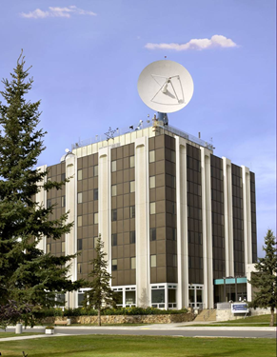
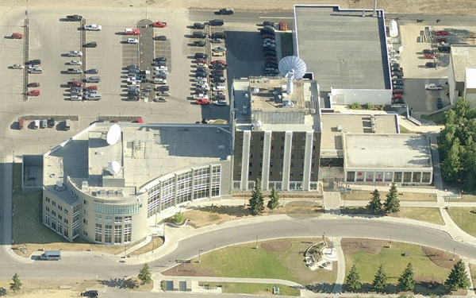
Near Earth Network AS2 Replacement
Systems Requirements Review
November 19, 2015

Slide 2
Thursday, November 19, 2015 AS2 Replacement Project SRR Agenda
Time | Section | Presenter
13:00 | Introduction | Ryan Turner
13:15 | 2. Project Management | Ryan Turner
13:25 | 3. System Overview | Serhat Altunc
13:50 | 4. Operations Concept | Joe O’Brien
14:15 | 5. Requirements Management | Joe O’Brien
14:45 | Break | N/A
14:55 | RTVM | Carl Cramer
15:15 | 7. System Performance Analysis | Serhat Altunc
15:25 | 8. RMA Analysis | Serhat Altunc
15:35 | 9. Logistics and CM Plan | Pati Peskett
15:45 | 10. Environmental, Health, and Safety | Chris Quinn
15:55 | 11. Risk Management | Brenda Kunds
16:15 | 12. Conclusion | Ryan Turner
16:20 | Review Team Caucus and Out-brief | Review Team
16:30 | Adjourn

Slide 3
Introduction
Ryan Turner
1 | Introduction
2 | Project Management
3 | System Overview
4 | Operations Concept
5 | Requirements Management
6 | RTVM
7 | System Performance Analysis
8 | RMA Analysis
9 | Logistics and CM Plan
10 | Environmental, Health, and Safety
11 | Risk Management
12 | Conclusion

Slide 4
Welcome
Welcome
Logistics
Sign in
Safety / Exits
Restrooms
Telecon Number:
Number: 1-844-467-6272
Passcode: 663040
Lync Meeting Information:
Provided in System Requirements Review (SRR) Calendar Invite
Address: https://meet.nasa.gov/serhat.altunc/CYJ6262P
Be conscientious of those participating by teleconference. When asking a question please identify yourself and approach a microphone

Slide 5
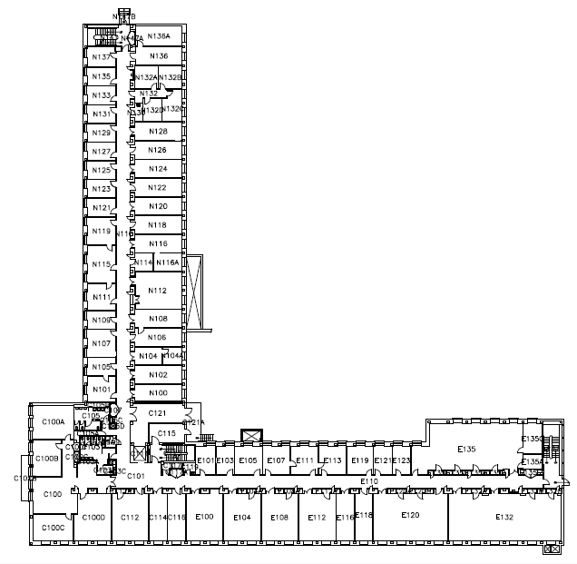
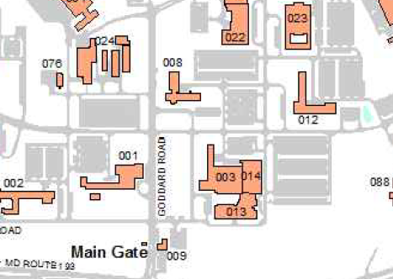
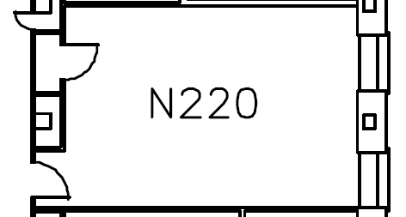
Logistics
Location: GSFC / Building 12/ Room N112
Stairs
N112
Restrooms
Stairs
Elevator
Stairs

Slide 6
AS2 SRR Review Team Members
The AS2 SRR Review Team consists of the following members:
Role & Responsibility | Name | Organization
Project Management and Chair | Andre Fortin | Code 566
Engineering & Integration | Armen Caroglanian | Code 566
Mission Needs, Goals and Objectives | Lynn Myers | Code 450.1

Slide 7
Request for Action (RFA) Process
Request For Action (RFA)
RFA should be significant enough to report to management
Proposed RFAs may be written by anyone
Proposed RFAs should be submitted to the Review Team chair
The review team will meet immediately following the review, assess RFA validity, and provide an initial copy of the RFA
The AS2 management, engineering leadership, and Review Team will meet to validate RFAs within one week of the review
RFA responses will be prepared by the assignee and coordinated with the originator for their acceptance or rejection
The AS2 Replacement Project Manager will track RFAs and will notify the Review Team chair after RFAs have been worked to the satisfaction of the originator, as requested
Action Item (AI)
AIs will be used for items that do not rise to the level of an RFA
AIs will be captured throughout the day and documented in the meeting minutes

Slide 8
NASA Procedural Requirements and SRR Purpose/Scope
The AS2 Replacement Project has been granted approval by the Review Team Chair on April 23, 2015 for a tailored implementation of NASA Procedural Requirements 7120.5E (project management) and 7123.1B (systems engineering) appropriate to its scope, risk and limited resources
Instructions documenting satisfaction of the tailored SRR entrance criteria, SRR agenda, and the review success criteria were provided to the Review Chair on April 23, 2015; updated instructions were sent on November 6, 2015
The purpose of this SRR is to demonstrate that the functional and performance requirements and the concept of operations defined for the replacement AS2 system (antenna and backend electronics) to be deployed at the Alaska Satellite Facility (ASF) at the University of Alaska in Fairbanks, Alaska are responsive to the Near Earth Network (NEN) Systems Requirements Document and the anticipated mission set

Slide 9
Project SRR Success Criteria [Based on 7123.1B – Table G-4]
# | Criteria
1 | The functional and performance requirements defined for the system are responsive to the parent requirements and represent achievable capabilities.
2 | The maturity of the requirements definition and associated plans are sufficient to begin Phase B.
3 | The project utilizes a sound process for the allocation and control of requirements throughout all levels, and a plan has been defined to complete the requirements definition at lower levels within schedule constraints.
4 | Interfaces with external entities and between major internal elements have been identified.
5 | Preliminary approaches have been determined for how requirements will be verified and validated.
6 | Major risks have been identified and technically assessed, and viable mitigation strategies have been defined.
7 | The project has demonstrated compliance with applicable NASA and implementing Center requirements, standards, processes, and procedures.
8 | TBD and TBR items are clearly identified with acceptable plans and schedule for their disposition.
9 | Software components meet the exit criteria defined in NASA-HDBK-2203, NASA Software Engineering Handbook.

Slide 10
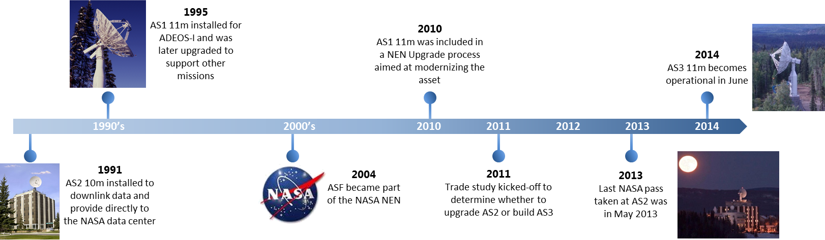
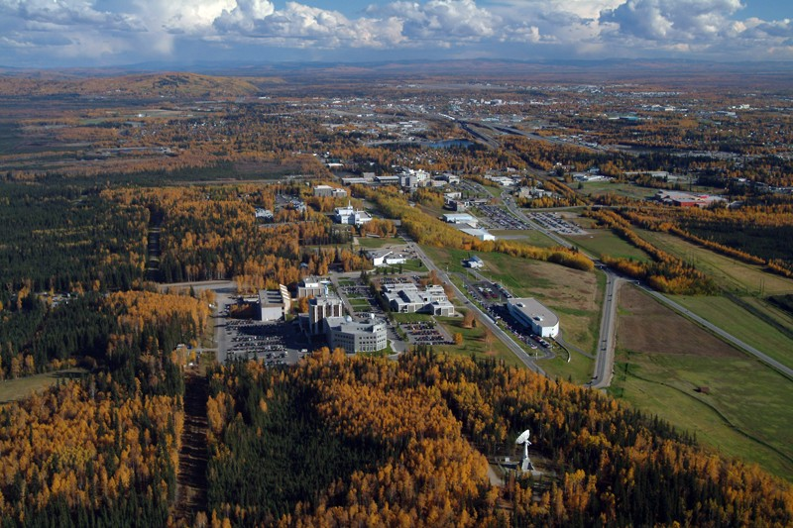
ASF Site Overview (1/3)
The Alaska Satellite Facility (ASF)—established in 1991 and operated by the Geophysical Institute (GI) of the University of Alaska Fairbanks—downlinks, processes, archives, and distributes remote-sensing data to scientific users around the world
ASF currently operates two antennas (AS1 and AS3) providing primary support to polar-orbiting, Earth-imaging spacecraft
2x11-meter, S/X-band (AS1 and AS3)
Non-operational: 10-meter, S/X-band (AS2)
The ASF assets have been used to support numerous NASA missions over the years
Over 15 different NASA missions
~50,000 passes since 2004

Slide 11
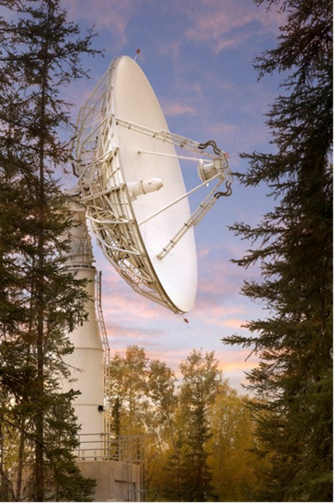
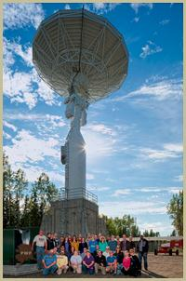
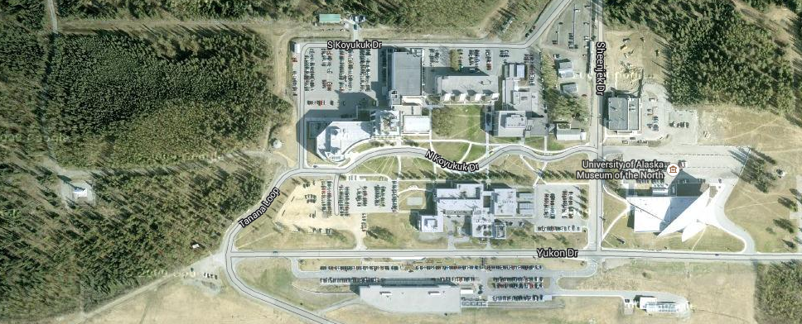
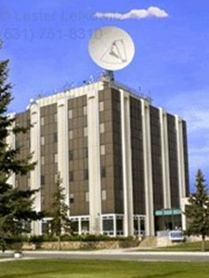
ASF Site Overview (2/3)
AS1
AS3
Alaska Satellite Facility
New AS2 Site
Elvey Building
ASF Control Center and staff

Slide 12
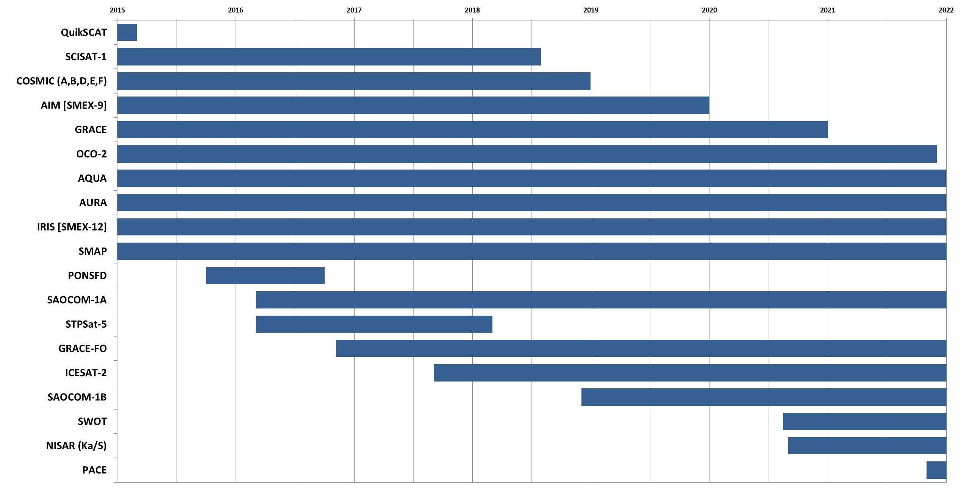
ASF Site Overview (3/3)
The timeline below provides the current and planned ASF mission set based on the SCMM:
Past missions Included: ERS-1, JERS-1, CHAMP, ERS-2, FAST, RADARSAT, TRACE, and SAC-D
FY 2016
FY 2017
FY 2018
FY 2019
FY 2020
FY 2021
FY 2022

Slide 13
AS2 Background
The existing AS2 antenna was installed at ASF on top of the Elvey Building in 1991, and is the original antenna at the ASF ground site
Primary purpose was support of planned synthetic aperture radar (SAR) satellites
OpsCon had downlinked SAR data transferred to the then new on-site data center for processing and distribution
Existing AS2 specifications:
Antenna is a ViaSat 10m system
Dual feeds for S-Band and X-Band reception
No transmission capability
Reflector is mounted to a Scientific Atlanta Series 3316 pedestal
Three axis: elevation-over-azimuth with a third axis tilt stage that eliminates a keyhole
Includes Antenna Control Unit (ACU) and back-end electronics

Slide 14
AS2 Replacement Project (1/2)
The AS2 system was taken out of operational service in May, 2013
December, 2011: AS2 suffered a mechanical failure of the tilt axis
Implemented a software workaround until ViaSat accomplished on-site fix in July, 2012
May, 2013: ASF conducted a planned power outage and ACU never came back online
The NEN initiated the AS2 Refurbishment Upgrade Project in the 2nd half of 2014 which included the following activities/objectives:
Disassemble and transport the AS2 system to the ViaSat vendor
Refurbishment of the mechanical equipment to the original manufacturer specifications
Feed refurbishment and upgrade (i.e., add S-Band transmission capability)
Transportation of all equipment back to ASF for reinstallation and testing
The AS2 Refurbishment Upgrade Project was to follow a four-phase SE process:
Phase 1: System Requirements Document (SRD)/SRR
Phase 2: Statement of Work (SOW) to award of subcontract to vendor
Phase 3: Vendor kick-off to System Acceptance Test (SAT)
Phase 4: Test Readiness Review (TRR)/Operational Readiness Review (ORR)
In November, 2014 the NEN initiated a trade study to verify whether the NEN should move forward with refurbishing the existing AS2 or replace it with a new asset
Initial findings were presented to NEN management on Dec. 19, 2014; see next slide

Slide 15
AS2 Replacement Project (2/2)
The November, 2014 trade study compared the costs and risks of upgrading the current AS2 10-meter system (with and without Ka-band) to those of procuring a new system capable of meeting the requirements of legacy and future missions
The study helped the NEN determine that the best approach to meeting its long tem goals while extending the capability of ASF out to 2030 with minimum risk is to replace the AS2 10-meter unit with a new S/X-band system
The long term objectives of the NEN include: maintain commonality, reduce obsolescence, reduce life cycle costs, and position the NEN to take on greater mission data flow rates and tracking capabilities
A new antenna will give greater incremental upgradability, prevent operational downtime, avoid single point failures during installation, offload commercial and AS1 and AS3 11-meter systems

Slide 16
AS2 Replacement Project Assumptions
New AS2 antenna will include an S-band uplink along with S and X-band downlink
New AS2 antenna will not be required to support Ka-Band
Antenna must be mounted on top of the Elvey Building
No major building modifications are anticipated
The Project has engaged the Professional Engineering firm Design Alaska to verify
Use the existing antenna pad with new interface plate
Using Commercial Off-The-Shelf (COTS) products to the maximum extent possible
Back-end electronics interface to the antenna is mature
Based on existing NEN architecture
Maximizing compatibility with existing NEN assets
Allows for sparing between existing assets to the maximum extent possible
Using existing M&C software to ensure compatibility with existing operations

Slide 17
Ryan Turner
Project Management
1 | Introduction
2 | Project Management
3 | System Overview
4 | Operations Concept
5 | Requirements Management
6 | RTVM
7 | System Performance Analysis
8 | RMA Analysis
9 | Logistics and CM Plan
10 | Environmental, Health, and Safety
11 | Risk Management
12 | Conclusion

Slide 18
AS2 Project Team

Slide 19
Project Management Overview
The NEN Project, currently in the Operations and Sustainment Phase, initiates development efforts as needed to ensure the NEN meets present and future commitments to missions identified in the agency mission model
Development efforts include architecting for future services and development of new systems designed to meet upcoming customer requirements
Development efforts adhere to the NEN Project Plan, specifically section 3.10 which addresses NEN Internal Development Project Reviews
The content for these reviews and the criteria used by the review teams to judge success of the review are defined in
NPR 7123.1 NASA Systems Engineering Processes and Requirements
GPR 8700.6 Engineering Peer Reviews
GSFC-STD-1001 Criteria for Flight Project Critical Milestone Reviews
The AS2 Project is encompassed within the NEN work breakdown structure (WBS) as captured in the NEN Project Plan and as documented in the Technical Implementation Plans of the supporting contracts
The AS2 Replacement Project was initiated in the latter half of 2014, subsequent to the failure of AS2 in May 2013
The AS2 Replacement Project SRR is the first major review being held for the development project

Slide 20
AS2 Project Lifecycle
Based on the size and scope of this project, the Preliminary Design Review (PDR) and Critical Design Review (CDR) will be combined into a single System Design Review (SDR)

Slide 21
Implementation Governing Documentation
As a development project under the NEN and being carried out by SCNS, AS2 will utilize a mix of AS2 Replacement Project documents as well as governing NEN and SCNS documents for systems engineering, engineering management, quality assurance, configuration management, and software development
AS2 Replacement Project Products:
AS2 SRD (453-SRD-AS2 Upgrade), distributed November 16, 2015
AS2 RTVM (SCNS-NEN-RTVM-0003), distributed November 16, 2015
NASA NEN Products:
NEN SRD (453-SRD-NEN)
NEN Users’ Guide (453-NENUG)
NEN Project Plan (453-PLAN-0004)
Ground Network Project Risk Management Plan (453-PLAN-0003)
SCNS Products:
SCNS Prog. Management Level Configuration Management Plan (SCNS-PMO-PLAN-0003)
SCNS Systems Engineering Management Plan (SCNS-NEN-PLAN-0005)
SCNS Engineering and Configuration Management Process (SCNS-NEN-LOP-0002)
SCNS Quality Assurance Plan (SCNS-PMO-PLAN-0007)
SCNS NEN Configuration Review Board Charter (SCNS-NEN-CRB-0001)
SCNS Risk Management Process (SCNS-PMO-PLAN-0020)

Slide 22
Document Tree

Slide 23
AS2 Replacement Project Efficiencies
The AS2 Replacement Project plans to benefit and realize development and implementation efficiencies through:
Leveraging a vetted design (i.e., existing NEN ground sites)
Use of commercial technology
Implementation of international data standards and protocols
All planned AS2 hardware and software includes efficient reuse of current equipment models and industry-standard technology, providing mature and operationally proven subsystems for the AS2 System
Subsystem | TRL | Assessment
ANTS | 9 | Implementation consists of standard products utilizing established technologies.
RF & IF | 9 | Significant re-use of existing equipment type and technology.
Signal Processing | 9 | Significant re-use of existing equipment type and technology.
M&C | 9 | Significant re-use of existing equipment type and technology.
Timing | 9 | Significant re-use of existing equipment and technology.

Slide 24
AS2 Replacement Project Key Milestones
September 30, 2015: SRD CCB
November, 2015: Distribute draft SRD and RTVM
November, 2015: Conduct SRR
December, 2015: SCNS antenna procurement task award
April, 2016: Antenna vendor contract award
June, 2016: Antenna vendor System Design Review
July, 2016: System Design Review
January, 2017: Factory Acceptance Test
March, 2017: Site Acceptance Test
May, 2017: Test Readiness Review
August, 2017: Operational Readiness Review
* The AS2 replacement project schedule is available upon request

Slide 25
Project Management Summary
SRR Entrance Criteria satisfied (E-4, E-5b, E-6g, E-6l, E-6m, E-6u)
(4, 6g) Programmatic products, consisting of AS2, NEN, and SCNS documents were presented on the “Implementation Governing Documentation” slide
(5b) The AS2 Replacement project will be utilizing the SCNS Systems Engineering Management Plan (SCNS-NEN-PLAN-0005)
(6l, 6m, 6u) An updated schedule was provided as well as key milestones; cost information has been provided directly to NEN management
SRR Success Criteria evidence (S-9)
(9) Project management process will support completion of the definition activity within schedule constraints

Slide 26
System Overview
Serhat Altunc
1 | Introduction
2 | Project Management
3 | System Overview
4 | Operations Concept
5 | Requirements Management
6 | RTVM
7 | System Performance Analysis
8 | RMA Analysis
9 | Logistics and CM Plan
10 | Environmental, Health, and Safety
11 | Risk Management
12 | Conclusion

Slide 27
AS2 System Overview
The new AS2 antenna will operate similar to AS1 and AS3, utilizing similar processes, designs, and COTS products based on the existing NEN Architecture
Allows for sparing between existing assets to the maximum extent possible
Maximizes the compatibility with existing NEN assets
Using existing M&C software to ensure compatibility with existing operations*
New AS2 antenna will include an S-band uplink along with S and X-band downlink
New AS2 antenna will not be required to support Ka-Band
Antenna will be mounted on top of the Elvey Building
No major building modifications are anticipated
* The AS2 replacement project is working with Code 300 to ensure software compliance with NASA-HDBK-2203

Slide 28
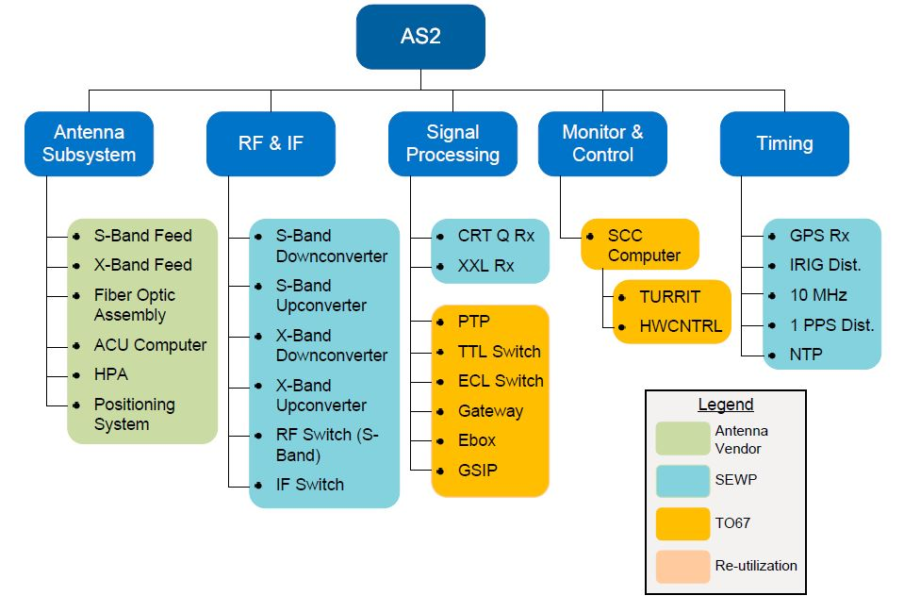
AS2 Subsystems and Configuration Items

Slide 29
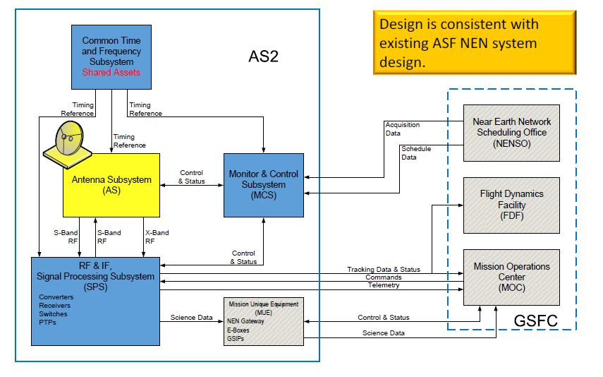
AS2 Subsystem and External Interfaces

Slide 30
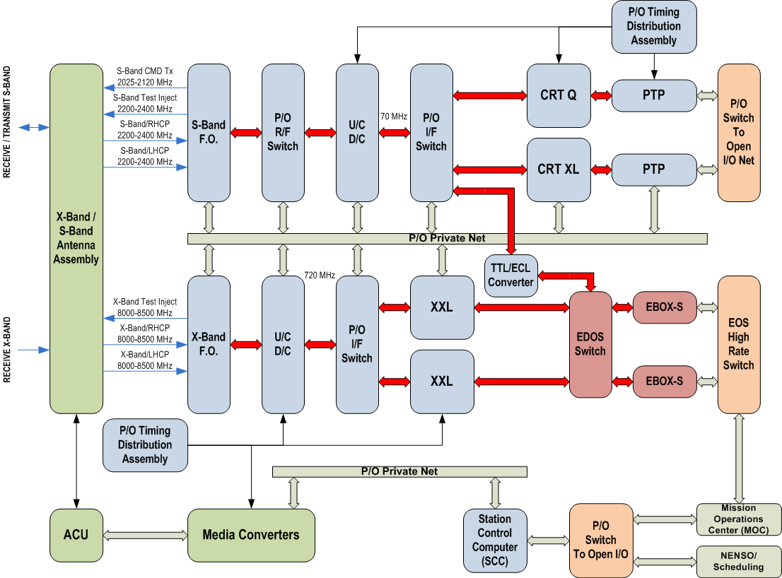
AS2 Architecture Diagram

Slide 31
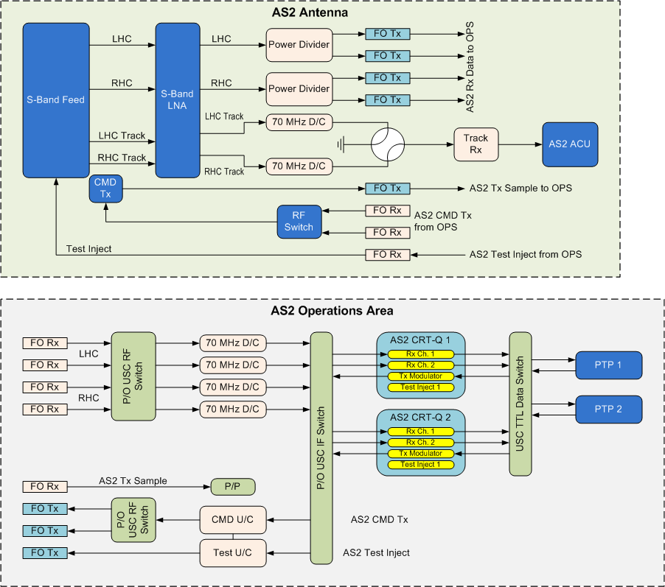
AS2 S-Band Signal Flow

Slide 32
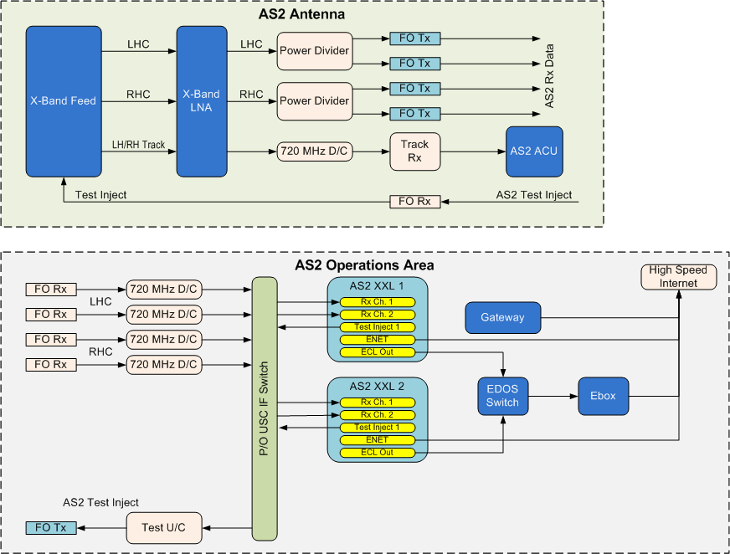
AS2 X-Band Signal Flow

Slide 33
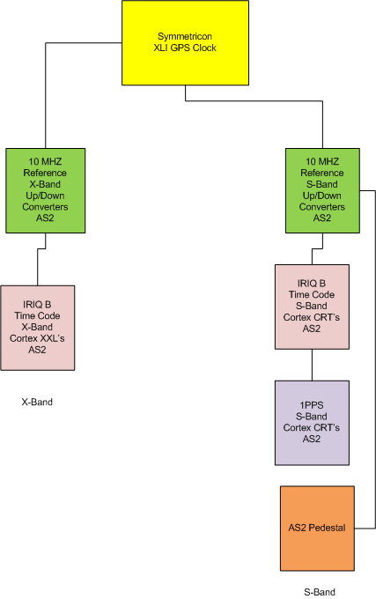
Common Time and Frequency Subsystem
AS2 will leverage existing timing system currently in place at ASF

Slide 34
Monitor & Control Software (1/2)
Monitor & Control (M&C) is performed by the ASF Station Control Computers (SCC) running the software application HWCNTRL (pronounced “hardware control”)
HWCNTRL is already in use for AS1, AS3, WG1, Wallops 5-meter (WG2), MG1, MTRS, WS1, and commercial stations that support the NEN in Svalbard. HWCNTRL was used for the AS2 system prior to the antenna failure
HWCNTRL is a COTS product for which we hold a license to co-develop
SCNS engineering develops M&C for new instruments and maintains the software
The new AS2 instance of HWCNTRL will use different .dll files than AS1 and AS3 in order to customize M&C for instruments that are not common across the three systems*
New .dll files will be written for the antenna controller and any new types of equipment used for data processing, if required
TURRIT (Tracking, UTDF and Ranging Real-Time Integration and Transmission) application will provide tracking data functionality
Status Server packet generation is incorporated in HWCNTRL and will provide station status to the Remote Status Server at Wallops
* The AS2 replacement project is working with Code 300 to ensure software compliance with NASA-HDBK-2203

Slide 35
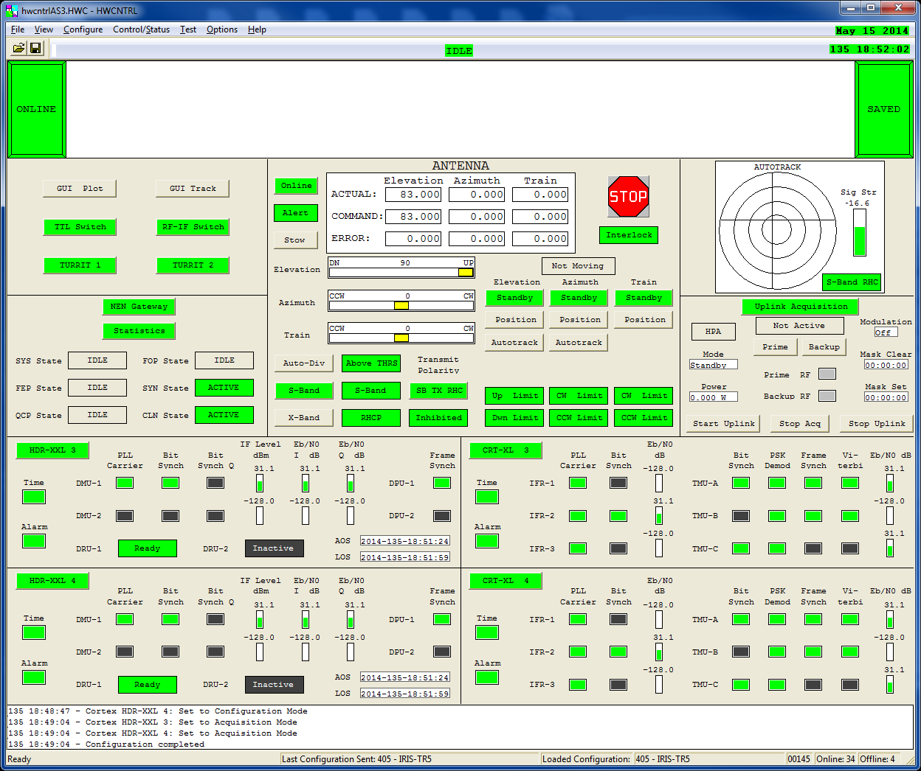
Monitor & Control Software (2/2)
HWCNTRL
Example
Main Screen (customized per station)

Slide 36
System Overview Summary
Architecture is mature and achievable
SRR Entrance Criteria satisfied (E-6b, E-6t, E-6v)
(6b, 6t) Operations concept is mature
(6v) All AS2 software components will fall under software category C. The AS2 project will use mature Commercial-Off-The-Shelf (COTS) hardware with embedded software. The M&C software is an existing product that will be modified for this application. The AS2 development project is working with Code 300 to ensure software compliance with NASA-HDBK-2203
SRR Success Criteria evidence (S-4, S-9)
(4) Interfaces with external entities and between major internal elements have been identified
(9) The AS2 development project is working with Code 300 to ensure software compliance with NASA-HDBK-2203

Slide 37
Operations Concept
Joe O’Brien
1 | Introduction
2 | Project Management
3 | System Overview
4 | Operations Concept
5 | Requirements Management
6 | RTVM
7 | System Performance Analysis
8 | RMA Analysis
9 | Logistics and CM Plan
10 | Environmental, Health, and Safety
11 | Risk Management
12 | Conclusion

Slide 38
Implementing Services
Network Integration Management Office (NIMO) assigns a Networks Integration Manager (NIM) to serve as an initial contact for the antenna service verification process
The NIM works with the NEN PAO to determine appropriate on-orbit customers for services from AS2. The NIM advises the customers and solicits their participation
NIM and customer Mission Commitment Engineer (MCE) assist the NEN Performance Analyst Office (NENPAO) in documenting the operational requirements
The NEN PAO coordinates with each mission to establish a test program
The NEN PAO and NEN operations team:
Work with each customer to prepare for testing (i.e., connectivity, firewall rules, etc.)
Coordinate the mission’s interfaces (i.e., NEN Scheduling System, Mission Data Delivery, and Station Status Delivery)
Work with FDF to certify the antenna for FDF services
The NIM and MCE update official agreements for network services
AS2 will be using existing NEN concept of operations

Slide 39
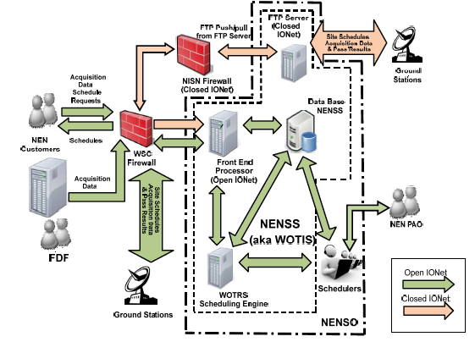
Scheduling
453-UG-NEN Scheduling
NENPAO works with NEN customers
NEN Scheduling System (NENSS) is used for scheduling
AS2 will be using existing NEN scheduling process

Slide 40
Operations Concept Timeline
AS2 will be using existing NEN concept of operations

Slide 41
Routine Operations (1/2)
Key Operational Tasks
Maintain AS2 station capabilities
Real-time operational services are identical to current NEN concepts
3 minutes prior to Acquisition of Signal (AOS), the station automation will start configuring for the pass
Operations & Maintenance (O&M) personnel will monitor the automated system configuration during setup
Problems during setup will be identified and addressed following pre-defined recovery procedures
Prior to AOS, the MOC commences monitoring AS2 status and will confirm scheduled parameters, recommend any configuration changes (by voice), and confirm station readiness for the pass

Slide 42
Routine Operations (2/2)
During each support, the O&M personnel will be closely monitoring the control computer for equipment status to ensure that all scheduled data services are provided
O&M personnel will switch over to backup equipment, where possible, in the event of a failure on a prime piece of equipment
Site status will be available for distribution to the customer via the NEN status server
Service losses will be reported by the MOC to operations as they occur and vice versa
O&M personnel will use the Comprehensive Discrepancy System (CDS) database to track operational problems; significant events will be reported utilizing the Station Status message process and the Significant Event Report (SER) system per NEN procedures
O&M personnel will provide NEN management with weekly activity reports for the site in accordance with current NEN procedures

Slide 43
Operations and Maintenance Approach
O&M for AS2 will be accomplished in the same way as AS1 and AS3 O&M, for which ASF provides:
Operations Services
Operators on duty 24x7 to monitor systems and configurations
On-call support 24x7 for anything beyond the limits of normal operations
Maintenance Services
Maintenance technician on call 24x7
Scheduled events
Unscheduled events
AS2 will utilize the current reporting system for Status Reports, NAMs, SERs, DRs, etc.

Slide 44
Operations and Maintenance Staffing
AS2 O&M will be provided by existing ASF staff; ASF staffing will remain unchanged beyond current levels
Senior Engineer
Electronics Technician
6 Operators
Time shared staff with NASA Data Center
Management
Administrative
Information Technology (IT) (e.g., networking, hardware support)
Software development

Slide 45
Maintenance
AS2 maintenance procedures will be the same as AS1 and AS3
ASF performs Monthly, Quarterly, and Annual preventative maintenance per the manufacturer recommendations
Complete system inspections
Specific inspections per any issued operations directives
Lubrication and gearbox inspections
ASF performs Emergency maintenance, if required
Staff on call 24x7 for any system failure

Slide 46
Training and Certification
ASF will provide the following training:
Operator
ASF provides in-house training for operators on customer spacecraft, policies, procedures, and security
System is fully automated; operations consists of monitoring and fault correction
Maintenance personnel will be involved in installing and testing the system
Fall Protection
ASF has a certified fall protection trainer on staff to provide training
Manlift
ASF receives regular manlift training from local trainer
Antenna vendor to provide:
Initial operations and maintenance familiarization training
Maintenance procedures

Slide 47
Reference Documents
NEN User’s Guide: 453-NENUG
Provides overview of the NEN
Describes how to obtain NEN services
Details asset capabilities
NEN Scheduling Guide: 453-UG-NEN Scheduling
Details NEN scheduling services
Includes: Pre-launch, launch, early orbit phases as well as nominal and off-nominal operations
NEN Link Commitment Schedule
Details site coverage availability and staffing hours

Slide 48
Operations Summary
AS2 Operations Concept is well developed
SRR Entrance Criteria satisfied (E-6b, E-6t, E-6v)
(6b, 6t) The concept of operations for AS2 was described in the presentation material
(6v) All AS2 software components will fall under software category C. The AS2 replacement project will use mature Commercial-Off-The-Shelf (COTS) hardware with embedded software. The M&C software is an existing product that will be modified for this application. The AS2 replacement project is working with Code 300 to ensure software compliance with NASA-HDBK-2203
SRR Success Criteria evidence (S-9)
(9) Selected concept of operations is mature will satisfy the mission and can be delivered using available software technology

Slide 49
Requirements Management and Traceability
Joe O’Brien
1 | Introduction
2 | Project Management
3 | System Overview
4 | Operations Concept
5 | Requirements Management
6 | RTVM
7 | System Performance Analysis
8 | RMA Analysis
9 | Logistics and CM Plan
10 | Environmental, Health, and Safety
11 | Risk Management
12 | Conclusion

Slide 50
AS2 SRD Overview and Traceability
AS2 will be implemented as a standard NEN Ground Station
Supporting S-Band up and downlink services
Supporting X-band downlink services
Requirements similar to AS1, AS3 and other NEN sites
AS2 SRD incorporates all applicable level 3 requirements contained within the NEE SRD and applicable lower level mission specific requirements from mission requirements documents, e.g., Network Requirements Documents (NRD), Network Operations Support Plans (NOSP)
AS2 Project is following the requirements process described in the Requirements Management Process depicted on the following slide
There is currently no To Be Resolved (TBR)/To Be Determined(TBD) information being tracked for AS2
Configuration Management (CM)of the SRD is as described in Section 9, Logistics and CM Plan
The AS2 SRD is available upon request; representative requirements are presented on the following slides

Slide 51
Requirements Management Process
Initial SRD from NASA
Configure RTVM
Establish Managed Requirements Baseline
Establish Traceability
Configure Repository Change Management System
Manage and Track Req. Change
Requirements Reporting
Req. Analysis and Functional Decomposition
Allocate System Requirements to Subsystems
Develop Subsystem Requirements
Publish RTVM
Change Management Process
Phase 1 - Establishing Baseline
Phase 2 - Analysis
Phase 3 – Change Management
Develop Requirements Management Plan
Planning and implementation
Define requirements data model tool
Import draft SRD into tool (Excel)
Allocate requirements to subsystems
Establish traceability
Determine requirement test level and method
Establish baseline
ID waivers and deviations
Define requirements change process/procedures
Track requirements change drivers
Update and maintain baseline requirements
Review and Reporting

Slide 52
Requirements Approach
The AS2 System Requirements Document was developed based on mission-specific and documented project requirements
In Scope: Testable requirements that are directly tied to the performance or functionality of the equipment at ASF
Out of Scope: Requirements dealing with other NEN locations and non-applicable activities (e.g., Modeling, Service Coordination, etc.)
Program/Project requirements approach:
Utilized the NEE SRD which collectively captures all legacy mission requirement documents (Phase 0), future requirements (Phase 1), and encompasses applicable SCaN SRD requirements
Mission Specific requirements approach:
Included lower level requirements that influenced the design but were not captured in the SRDs or NEN Users’ Guide
Example missions include IRIS, SMAP, and QuikSCAT
SCaN SRD – Phase 0 and 1
NEE SRD – Phase 0 / NEN UG ¹
Legacy Mission Specific Req.
Future Mission Specific Req.
AS2 SRD
¹ The NEN Users’ Guide was used to identify relevant capabilities required of the NEN that were not captured in either the SCaN SRD or NEE SRD.

Slide 53
Requirements Allocation Process
System Requirements Document (SRD) System Level Requirements
System Level
Subsystem Level Requirements and Interface Control Document (ICDs
Subsystem Level
Unit Level Requirements and ICDs
CI Level
System Level requirements contained in the AS2 Systems Requirement Document trace to parent NEE System Requirements Document (453-SRD-NEE) requirements

Slide 54
AS2 SRD Structure
Section | Description | # of Reqmts.
System Specifications | Includes all performance specifications | 134
Antenna System | Antenna specific: G/T, EIRP, Freq, etc. | 17
Service Coverage | Min elevation angle, TX inhibit mask, dual polarization | 4
S-Band Uplink | Includes command & ranging | 10
S-Band Downlink | Includes tracking and telemetry | 16
X-Band Downlink | Includes tracking and telemetry | 15
Tracking | Radiometric tracking services | 3
Monitor & Control | High level M&C: logging, status, reconfiguration | 6
External Ground Interface | Addresses interfaces to CSO,FDF,MOCs and Mission unique requirements | 14
General Antenna/Backend Electronics | Environmental, power, interlocks, structural, lightning, security & Timing | 49
Operational, Inherent Availability & Sparing | Availability, system life, and sparing requirements | 4
Environmental Health & Safety | Health and safety requirements | 6

Slide 55
Driving Requirements
Rqmt. | Description Summary | Comment
AS2-2430 | AS2 Antenna shall be located on top of the Elvey Building | Structural and performance requirements will drive antenna size
AS2-0070 | S-Band G/T ≥ 21.0 dB/K at 5° elevation over the frequency range of 2200-2400 MHz | Per NEE SRD, ≥ 21.0 dB/K
AS2-0130 | X-Band G/T ≥ 32.0 dB/K at 10° elevation over the frequency range of 8000-8400 MHz | Per NEE SRD, ≥ 31.0 dB/K
AS2-0060,0080 | S-Band EIRP ≥ 56.0 dBW over the frequency range of 2025-2120 MHz | Per NEE SRD, ≥ 56.0 dBW
AS2-0800 | Radiometric Tracking Services | Per NEE SRD Table 5-4, which drove the development of AS2 SRD Table 7.
AS2-0150,0160,0170 | RF over fiber for S and X-band | Up/Down converters will be located on the ops floor. RF will be brought down via fiber from the antenna
AS2-0020 | S-Band Uplink Frequency: 2025-2120 MHz
AS2-0010 | S-Band Downlink Frequency: 2200-2400 MHz
AS2-0090 | X-Band Downlink Frequency: 8000-8400 MHz

Slide 56
S-Band Antenna System Requirements
Requirement | Description
AS2-0010 | The AS2 S-Band antenna system shall have a downlink frequency range of operation of 2200-2400 MHz.
AS2-0020 | The AS2 S-Band antenna system shall have an uplink frequency range of operation of 2025-2120 MHz.
AS2-0030 | The AS2 S-Band antenna shall have auotrack capability with a pointing accuracy of .05 degrees RMS.
AS2-0040 | The AS2 S-Band antenna polarization shall be RHCP and LHCP (simultaneous receive), RHCP or LHCP (transmit selectable).
AS2-0045 | The AS2 S-Band antenna shall transmit selectable RHCP and LHCP polarizations.
AS2-0050 | The AS2 S-Band antenna axial ratio shall not exceed 1.0 dB
AS2-0060 | The AS2 S-Band antenna minimum effective isotropic radiated power shall be 56 dBWi over 2025-2120 MHz.
AS2-0070 | The AS2 S-Band antenna system G/T shall be greater than or equal to 21.0 dB/K from 2200-2400 MHz at 5° of elevation referenced to the input of the S-band receiver.
AS2-0080 | S-band G/T through 2200-2400 MHz shall be met with system transmitting through 2025-2120 MHz at required EIRP.

Slide 57
X-Band Antenna System Requirements
Requirement | Description
AS2-0090 | The AS2 X-band antenna frequency range of operation shall be 8000 to 8500 MHz.
AS2-0100 | The AS2 S-band antenna shall have auotrack capability with a pointing accuracy of .05 degrees RMS.
AS2-0110 | The AS2 X-band antenna polarization shall be RHCP and LHCP (simultaneous receive).
AS2-0120 | The AS2 X-band antenna axial ratio shall not exceed 1.0 dB.
AS2-0130 | The AS2 X-Band antenna G/T shall be greater than or equal to 32.0 dB/K from 8000-8500 MHz at 10° of elevation referenced to the input of the X-Band receiver.
AS2-0140 | X-band G/T through 8000-8500 MHz shall be met with system transmitting through 2025-2120 MHz at required EIRP.

Slide 58
S-Band Uplink Requirements
Differential
Decoder
FEC
Decode
Derandomize
Frame Synch
Remove ASM
Bit Synch
Demodulate
AS2 SRD
Table 3
Modulate
AS2 SRD Table 5
Coding Schemes
AS2 SRD
Table 7 Tracking
Frame Synch
Remove ASM
Differential
Encoder
FEC
Encode
Randomize
Reappend ASM (TBR)
64 bit
AS2 SRD Table 4: Fwd Link Data Rates
(includes all NEE framing overhead and ASM)

Slide 59
S-Band Downlink Requirements
TLM
Data
Differential
Encoder
FEC
Encode
Randomize
Append
ASM
64 bit
Modulate
Demodulate
Diversity Combining
AS2 SRD Table 3
<=10-8
Differential
Decoder
FEC
Decode
Derandomize
Frame Synch
Remove ASM
Bit Synch
AS2 SRD Table 5
Coding Schemes
Up to 6 Mbps encoded bit rate
at the output of the demodulator

Slide 60
X-Band Downlink Requirements
TLM
Data
Differential
Encoder
FEC
Encode
Randomize
Append
ASM
64 bit
Modulate
Demodulate
Diversity Combining
AS2 SRD Table 3
<=10-8
Differential
Decoder
FEC
Decode
Derandomize
Frame Synch
Remove ASM
Bit Synch
AS2 SRD Table 5
Coding Schemes
Up to 300 Mbps encoded bit rate
at the output of the demodulator

Slide 61
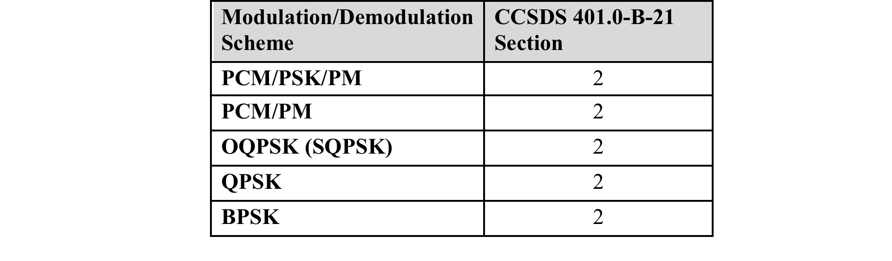
Modulation/Demodulation Schemes
AS2 SRD Table 3. NEN Modulation and Demodulation Schemes
Modulation and Demodulation schemes listed in Table 3 apply to all forward and return links

Slide 62
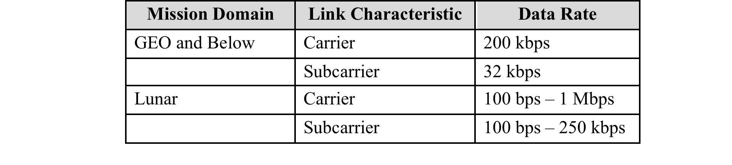
Forward Link Data Rates
AS2 SRD Table 4. NEN Forward Link Data Rates
These rates include all NEE framing overhead including Attached Sync Marker (ASM)

Slide 63
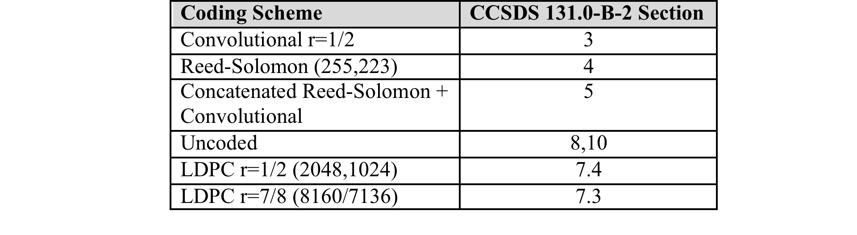
Channel Coding Schemes
AS2 SRD Table 5. NEN Channel Coding Schemes

Slide 64
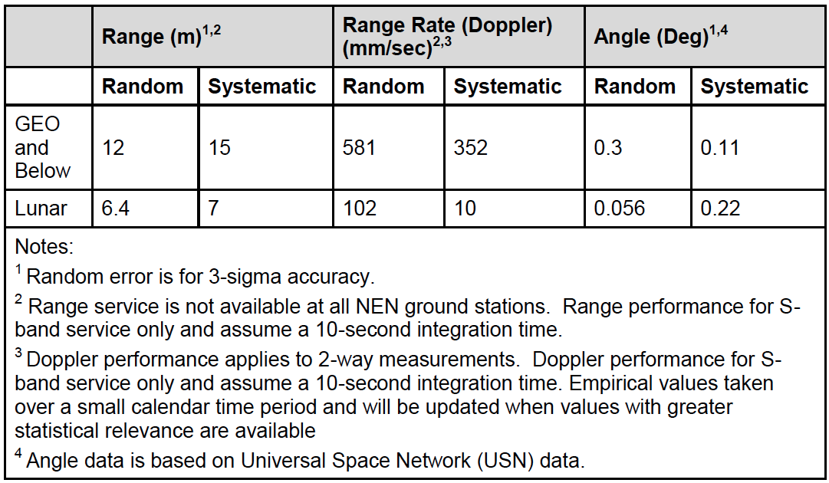
NEN Tracking Services
AS2 SRD Table 7. NEN Tracking Services

Slide 65
External Interface Requirements
CSO Services
Provides transport and delivery services
Controls the NASA Integrated services Network (NISN)
Receives telemetry data from the ground station for routing to customer MOCs
FDF Services
Provides acquisition data to the ground station
Validates NEN tracking accuracy
Customer MOCs
Mission unique control centers
Interface specifics defined in mission specific NRDs
Mission Unique Equipment (MUE)
Mission specific hardware that is required to augment standard AS2 ground station services
Customer specific equipment integrated into the ground station architecture

Slide 66
General Antenna/Backend Electronics
Rack Mountable Equipment Specifications
General Software Specification
Antenna Limits, Interlocks, Hand Crank, and Stow Pins
Environmental Specifications
Rain, Wind, Temperature, Humidity, Seismic, etc.
Structural Requirements
Capability to be mounted to the top of the Elvey Buidling
Power Requirements
Lightning Protection
Station Surveillance Video & Audio
Local Area Network and Network Requirements
Station Timing

Slide 67
Operational, Inherent Availability & Sparing
Requirement | Description
AS2-2590 | AS2 shall achieve an operational availability (Ao) of 0.95.
AS2-2600 | AS2 shall achieve an inherent availability (Ai) of 0.995.
AS2-2610 | The AS2 shall be designed for a minimum life span of 20 years.
AS2-2620 | The AS2 on site depot shall store one shelf spare for each back-end electronic component and include HPA and LNA.
AS2-2625 | The AS2 shall have spare Line Replaceable Units (LRU) that are required to support the achievement of the required operational availability.

Slide 68
Environmental Health & Safety
Compliance with NASA Procedural Requirement (NPR) 8715.3, NASA General Safety Program Requirements
Comprehensive analysis of project lifecycle to ensure personnel and system safety
RF Radiation avoidance
Software masking and physical hard stops to prevent RF transmission below 5 degrees of elevation
Entrances to Elvey Building roof shall be locked and warning signs posted
Per AS2-2670, Antenna anchor points shall be designed in accordance with the ANSI Z359 Fall Protection Series and OSHA Standard 1910.66, Personal Fall Arrest System, and 1926.502, Fall Protection Systems Criteria and Practices

Slide 69
Requirements Management and Traceability Summary
Requirements management process will ensure AS2 requirements are complete and responsive to parent requirements
Requirements developed to date will satisfy AS2 replacement purpose and goals
SRR Entrance Criteria satisfied (E-5a, E-6c, E-6j)
(5a) AS2 SRD and AS2 RTVM are mature and ready to be baselined
(6c) Project requirements trace to the baselined NEE SRD, which traces to the SCaN SRD
(6j) Driving requirements have been identified and are included in the presentation
SRR Success Criteria evidence (S-1, S-2, S-3, S-4, S-8, S-9)
(1) Requirements are responsive to the NEE SRD parent requirements and GRACE FO NRD and are achievable
(2) AS2 SRD is very mature and reflects well understood operations concepts and is achievable using readily available technology
(3) Requirements are allocated to sub-systems within the SRD. Changes will be managed in accordance with Configuration Management Procedure 450-PG-1410.2.1 by NASA CCB
(4) Requirements for internal and external interfaces are defined in the requirements document
(8) There are currently no TBRs/TBDs being tracked for AS2
(9) Software requirements are mature, meet mission requirements, and are allocated at the sub-system level as required by NASA-HDBK-2203 SRR exit criteria

Slide 70
RTVM
Carl Cramer
1 | Introduction
2 | Project Management
3 | System Overview
4 | Operations Concept
5 | Requirements Management
6 | RTVM
7 | System Performance Analysis
8 | RMA Analysis
9 | Logistics and CM Plan
10 | Environmental, Health, and Safety
11 | Risk Management
12 | Conclusion

Slide 71
Verification and Validation Process
Verification and Validation
Verification*: Verification testing relates back to the approved requirements (AS2 System Requirement Document) and can be performed at different stages in the product life cycle. Can be expressed by the query “Are you building it right?”
Validation*: Validation testing relates to the concept of operations. Validation testing is conducted under realistic conditions (or simulated conditions) on end products for the purpose of determining the effectiveness and suitability of the product for use in mission operations by typical users. Can be expressed by the query “Are you building the right thing?”
The objectives of the SCNS Verification and Validation (V&V) process are to verify that all the requirements placed upon the SCNS infrastructure by the missions have been met and to validate that the overall SCNS infrastructure accomplishes its intended purposes when used in its intended environment as specified by the Mission set. Any anomalies discovered during validation will be documented and appropriately resolved. The SCNS process conforms to the guidelines given in NASA 7120.5E
During this phase, from a test and operations point of view, test plans, test and operations procedures are developed and verified, as well as the ground systems and databases used to implement them
The purpose of the test plan is to describe the Level 1 through Level 4 Integration and Test (I&T) activities for the ASF system. This document is a software/hardware test plan which includes definition of the test levels, implementation and test approach, test requirements, roles and responsibility, test conduct and reporting
* Per NASA System Engineering Handbook

Slide 72

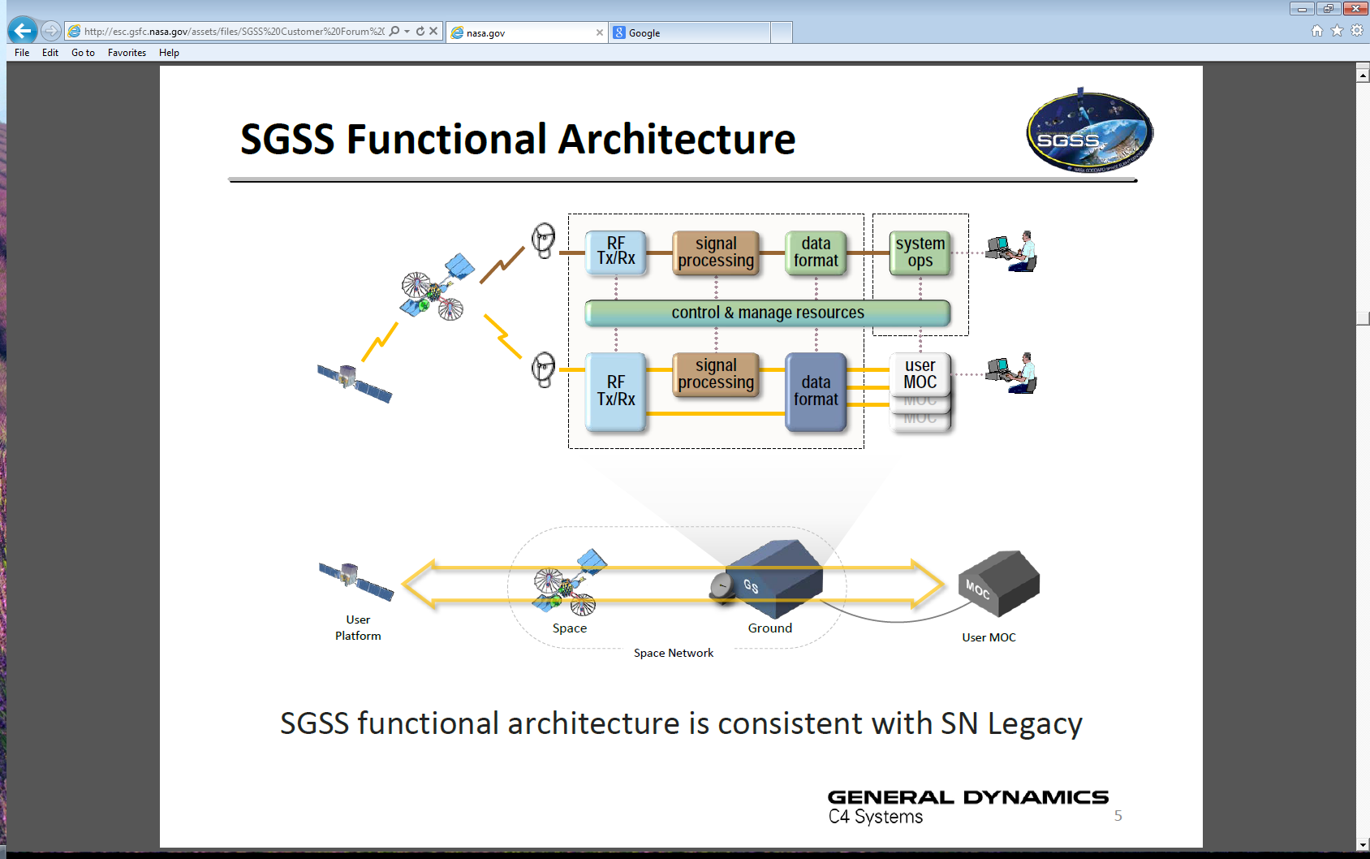
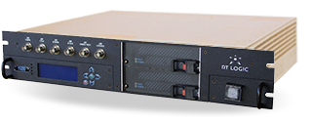
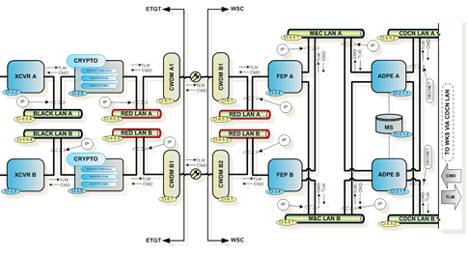
Test Levels
Level 1 Component
Level 4 System Integration
Level 2 CI
Level 5 System Acceptance
Level 3 Subsystem Integration

Slide 73
Test Levels/Plan (1/3)
The NEN test approach is structured to provide an outline of all planned verification testing that is required to demonstrate the AS2 system is operationally ready to support ASF mission set for ground system readiness and spacecraft tests, and mission operations simulation and validation activities
Verification (I & T) Levels
Level 1 - Component: Vendor facility testing of discrete components (e.g., boards, integrated circuits) within a hardware unit or elements of software code within a software unit. Documentation review may suffice for Commercial Off-The-Shelf (COTS) items. Vendor bench testing in a controlled lab/test bed environment
Level 2 - Unit test: Vendor /Subsystem developer testing/facilities. Hardware/software unit specification compliance. Can be integrated hardware/software testing (COTS). Documentation review may suffice (COTS)

Slide 74
Test Levels/Plan (2/3)
Verification (I & T) Levels
Level 3 - Subsystem Integration Test: Assembly of multiple hardware/software units into a complete subsystem. Vendor or subsystem integration/development facility. Subsystem specification compliance and limited SRD verification
Factory Acceptance Testing (FAT): FAT’s procedures will be provided by the vendor and reviewed by the NEN Team, identifying each test requirement and will specify the objectives and verification criteria that will constitute an acceptable test. Testing will be performed at the vendor site locations on the newly procured or modified hardware. The testing will be performed by the vendor and may be witnessed by the SCNS Contractor or their designated representatives. Due to the commonality of the equipment being used in the NEN sites now not all FAT will be witnessed. The antenna vendor will be one of the FAT’s that will be witnessed by NASA or their representatives
Test Data Sheets: Test Data Sheets from FAT’s will be delivered to NEN engineering in a separate package by the vendor for all COTS HWCI’s to list performance specifications and verify compliance with NEN requirements. These test data sheets for each unit will be retained for archival history that will be needed for future presentations (TRR & etc…)
Engineering Test: Upon arrival at ASF each piece of equipment will be tested to ensure no damage during shipment and to characterize the units meet the desired requirements
Equipment Rack Integration: Equipment will be assembled into racks and tested at ASF by the ASF/NEN team. Subsystem level interface testing conducted with Bit Error Rate Test Simulators (BERT). The Cortex units will be used for this purpose and no separate testers will be part of the systems. Rack BER data flow testing will verify data flow and continuity of assembled equipment. Interconnect cable drawings can be generated at this time

Slide 75
Test Levels/Plan (3/3)
Verification (I & T) Levels
Level 4 - System Integration/Verification Test: Assembly of subsystems into end-to-end system. Blend of simulators (mission and test), recorded test data and actual devices (antenna, satellites, etc.). Hardware, Software, Infrastructure baseline establishment/compliance. Physical/logical configuration compliance and SRD verification
Level 5 - System Validation Test: End-to-end scenario-based testing in an operational environment. Verification of end-to-end SRD and operational requirements. Missions set functions and system functionality will be tested or demonstrated in the final system configuration at the ASF site. This is the final stage of testing process before system is accepted for testing with the missions. The system is tested with mission data rather than simulated test data

Slide 76
Verification Methods
Verification Method | Name | Description
I | Inspection | Verification of physical configuration or verification of data presence; includes conformance to drawings or data specifications. Examples might include physical dimensions of subsystem or examining data fields in a static database to ensure correct values are present.
A | Analysis | Verification by engineering analysis for requirements that cannot be realistically tested. Examples might include Reliability, Maintainability and Availability (RM&A) and timeline analysis for specified operational scenarios.
D | Demonstration | Verification through operations of a configured article designed to exhibit the functional capabilities of that article. Performance may be monitored, but success criteria are of a go/no-go nature as opposed to quantitative reduction, analysis and statistical confidence. Demonstration may be used to provide a point-estimate supporting, but not confirming, the results of an Analysis activity (e.g., Availability data collection supporting RM&A Analysis).
T | Test | Verification through interrogation and monitoring of a specific unit or configuration article under test. Specific test equipment may be required to measure system outputs, protocols, or performance. There is specific pass/fail criteria for each test case performed and in some cases multiple samples are required to achieve statistical confidence in the observed results.

Slide 77
Requirements Traceability Verification Matrix (RTVM) (1/2)
Per NASA Systems Engineering Handbook (NASA/SP-2007-6105 Rev 1)
Project-Level Requirements RTVM:
Reflect the requirements contained within the NASA SRD
Provide customer and project management visibility into the verification status of the high-level requirements
The data entry into the RTVM will be controlled by a Systems Engineer
Revision control is achieved through SCNS Sharepoint controls
RTVM will be placed in Excel
RTVM will be reviewed and updated on a periodic basis, as appropriate

Slide 78
Requirements Traceability Verification Matrix (RTVM) (2/2)
Requirements Traceability Verification Matrix*:
The purpose of the AS2 RTVM is to trace where requirements are derived from, how they are satisfied, how they are tested, and what impact will result if they are changed for support of the ASF mission set. The Requirements Traceability Verification Matrix (RTVM) is used to show traceability to a higher level requirement and to determine the best method(s) to verify each requirement System level requirements applicable to the AS2 system are allocated and decomposed to the subsystem hardware/software configuration items and/or interfaces as appropriate. The RTVM will be used to document pass/fail status as each requirement is verified during the testing at site during the Site Verification Test
RTVM Sample
* Full RTVM available upon request

Slide 79
AS2 Driving Requirements RTVM (1/2)
AS2 SRD Spec Paragraph | AS2 SRD ID | Title | AS2 SRD Requirement Statement (Level 3) | Subsystem Allocation | Parent Req. | Parent Requirement (NEE SRD Traceability)
3.1.2 | AS2-0130 | X-Band | The AS2 X-Band antenna G/T shall be greater than or equal to 32.0 dB/K from 8000-8400 MHz at 10° of elevation referenced to the input of the X-Band receiver | SYS | NEN1146 | NEN1142 The Ground System shall provide return services with the minimum G/T, at the input of the NEN for each frequency band and ground station as marked and specified in Table 5-11.
3.1.1 | AS2-0010 | S-Band | The AS2 S-Band antenna system shall have a downlink frequency range of operation of 2200-2400 MHz | ATS | NEN429 | NEN429 (The NASA NEE ground stations shall operate in the authorized frequency bands of Table 5-2.) NEE Authorized Frequency Bands Spectrum Bands/Sub-Bands Usage 2025 – 2110 MHz EESS, SRS, SOS, S-Forward (Earth-to-Space) 2200 – 2380.5 MHz EESS, SRS, SOS, S-Return (Space-to-Earth) 4400 - 4500 MHz TBD C-Band (Space-to-Earth) 8025 – 8400 MHz EESS X-Return (Space-to-Earth) 8450 – 8500 MHz SRS X-Return (Space-to-Earth)
3.1.1 | AS2-0020 | S-Band | The AS2 S-Band antenna system shall have an uplink frequency range of operation of 2025-2120 MHz | ATS | NEN429 | NEN429 (The NASA NEE ground stations shall operate in the authorized frequency bands of Table 5-2.) NEE Authorized Frequency Bands Spectrum Bands/Sub-Bands Usage 2025 – 2110 MHz EESS, SRS, SOS, S-Forward (Earth-to-Space) 2200 – 2380.5 MHz EESS, SRS, SOS, S-Return (Space-to-Earth) 4400 - 4500 MHz TBD C-Band (Space-to-Earth) 8025 – 8400 MHz EESS X-Return (Space-to-Earth) 8450 – 8500 MHz SRS X-Return (Space-to-Earth)
3.1.1 | AS2-0060 | S-Band | The AS2 S-band antenna minimum Effective Isotropic Radiated Power (EIRP) shall be 56 dBWi over 2025-2120 MHz. | ATS | NEN1130 | NEN1130 (The Ground System shall provide forward services with the minimum EIRP at the output of the NEN for each frequency band and ground station as marked and specified in Table 5 -6.)
3.1.1 | AS2-0070 | S-Band | The AS2 S-band antenna system G/T shall be greater than or equal to 21.0 dB/K from 2200-2400 MHz at 5° of elevation referenced to the input of the S-band receiver. | SYS | NEN1146 | NEN1142 The Ground System shall provide return services with the minimum G/T, at the input of the NEN for each frequency band and ground station as marked and specified in Table 5-11.

Slide 80
AS2 Driving Requirements RTVM (1/2)
AS2 SRD Spec Paragraph | AS2 SRD ID | Title | AS2 SRD Requirement Statement (Level 3) | Subsystem Allocation | Parent Req. | Parent Requirement (NEE SRD Traceability)
3.1.1 | AS2-0080 | S-Band | The AS2 S-Band antenna minimum effective isotropic radiated power shall be 56 dBWi over 2025-2120 MHz | ATS | NEN1130 | NEN1130 (The Ground System shall provide forward services with the minimum EIRP at the output of the NEN for each frequency band and ground station as marked and specified in Table 5 -6.)
3.1.2 | AS2-0090 | X-Band | The AS2 X-Band antenna frequency range of operation shall be 8025 to 8400 MHz | ATS | NEN429 | NEN429 (The NASA NEE ground stations shall operate in the authorized frequency bands of Table 5-2.) NEE Authorized Frequency Bands Spectrum Bands/Sub-Bands Usage 2025 – 2110 MHz EESS, SRS, SOS, S-Forward (Earth-to-Space) 2200 – 2380.5 MHz EESS, SRS, SOS, S-Return (Space-to-Earth) 4400 - 4500 MHz TBD C-Band (Space-to-Earth) 8025 – 8400 MHz EESS X-Return (Space-to-Earth) 8450 – 8500 MHz SRS X-Return (Space-to-Earth)
3.1.3 | AS2-0150 | RF Over Fiber | The AS2 antenna shall send S-Band RF from the antenna to downconverters located on the operations floor via fiber optics for the S-Band downlink. | SYS | NEN1123 or Derived Req. | NEN1123 The NEN shall achieve an operational availability (Ao) of 0.95.
3.1.3 | AS2-0160 | RF Over Fiber | The AS2 antenna shall receive S-Band RF from upconverters located on the operations floor via fiber optics for S-Band uplink. | SYS | NEN1123 or Derived Req. | NEN1123 The NEN shall achieve an operational availability (Ao) of 0.95.
3.1.3 | AS2-0170 | RF Over Fiber | The AS2 antenna shall send X-Band RF from the antenna to downconverters located on the operations floor via fiber optics for the X-Band downlink. | SYS | NEN1123 or Derived Req. | NEN1123 The NEN shall achieve an operational availability (Ao) of 0.95.
3.6.1 | AS2-0800 | Radiometric Tracking Services | The system shall provide radiometric tracking services. | SYS | NEN511 | NEN511 The Ground System shall provide radiometric tracking services specified in Table 5-4.
3.9.4 | AS2-2430 | Structural Requirements | The AS2 antenna shall be capable of being mounted on top of the Elvey Building at the University of Alaska, Fairbanks and still meet all performance requirements. | ANT | NEN1123 | NEN1123 (The NEN shall achieve an operational availability (Ao) of 0.95.) Facility Requirement

Slide 81
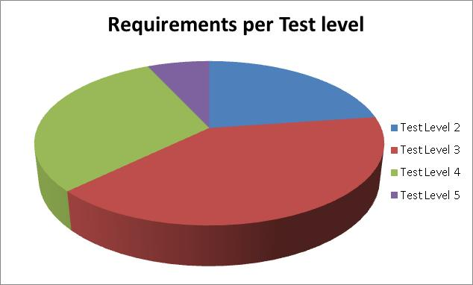
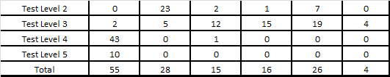
Requirement Analysis System and Test Level
Test Level Requirements per System and Subsystems
Most AS2 requirements are verified in Level 3 (subsystem level)
SYS requirements are verified in Level 4 and 5

Slide 82
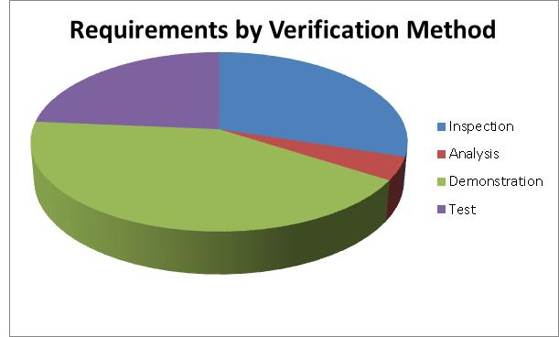
Requirement Analysis Verification Method and Test Level
Most AS2 requirements are verified by Demonstration in Level 3 (subsystem level)
Requirements verified by analysis include:
Transmit EIRP
Path latency
Operational availability
Data logging capacity
Receive power level survivability

Slide 83
RTVM Summary
SRR Entrance Criteria satisfied (E-6c, E-6h)
(6c) Completed RTVM with parent requirements assigned to all AS2 SRD requirements
RTVM will be submitted to SCNS NEN CRB (SCNS-NEN-RTVM-0003)
(6h) Assigned verification methods for each SRD requirement
SRR Success Criteria evidence (S-5, S-9)
(5) Reviewed preliminary verification approaches including test configuration for lab testing and deployed system end-to-end testing
(5) Identified test equipment needed to validate SRD requirements
(9) Preliminary approaches have been determined for how requirements will be verified and validated down to the subsystem level

Slide 84
System Performance Analysis
Serhat Altunc
1 | Introduction
2 | Project Management
3 | System Overview
4 | Operations Concept
5 | Requirements Management
6 | RTVM
7 | System Performance Analysis
8 | RMA Analysis
9 | Logistics and CM Plan
10 | Environmental, Health, and Safety
11 | Risk Management
12 | Conclusion

Slide 85
Supporting Analysis Overview
The AS2 Replacement project team has conducted three technical analyses that have helped to confirm and guide the AS2 system requirements process
RF Compatibility Analysis*
Structural Analysis
RMA Analysis (see next section)
RF Compatibility Analysis
Structural Analysis
RMA Analysis
Purpose:
Verify that the anticipated ASF mission set can be satisfied with multiple COTS antenna products and verify the NEE SRD performance requirements are sufficient for the new AS2 antenna system
Scope:
Multiple COTS Antennas
Current/Future ASF Mission Set
Purpose:
Verify that multiple COTS antenna products, which satisfy the performance requirements (e.g., G/T, EIRP), can be implemented on top of the Elvey building safely and without major building modifications
Scope:
Multiple COTS Antennas
Elvey Building Structural Parameters
Purpose:
Confirm that the AS2 Operational Availability (Ao) Requirements, traceable to the NEN Ao requirement, can be met with standard COTS equipment and components common to the NEN
Scope:
COTS Equip. Parameters
* Influenced system RF performance requirements AS2-0010, AS2-0020, AS2-0060, AS2-0070, AS2-0080, AS2-0090, and AS2-0140.

Slide 86
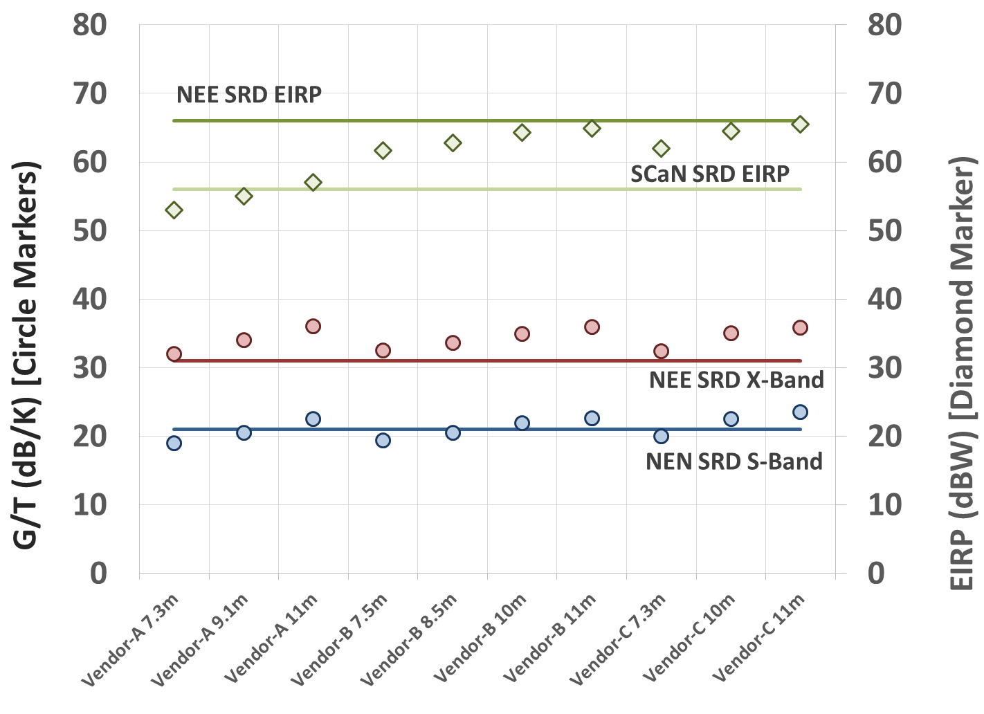
RF Compatibility Analysis – Status (1/2)
The initial step of the RF Compatibility Analysis consisted of a data collection effort to identify the G/T and EIRP capabilities of a number of potential COTS antennas
Data was collected from three potential vendors, two of which have a history with NEN
Reference S-Band and X-Band G/T and S-Band EIRP values were collected for various antenna sizes ranging from 7m to 11m
Data was captured in a matrix for further evaluation and follow on use
The second step of the analysis was to compare the advertised COTS antenna system performance values against the baselined SCaN and NEE SRD and AS2 SRD
Table Summary
S-Band G/T:
Five antenna options were above the NEE SRD requirement of 21 dB/K
The remaining antenna options were slightly below the NEE requirement
X-Band G/T:
All antenna options satisfied the NEE SRD requirement of 31 dB/K
S-Band EIRP:
No antenna option met the NEE maximum EIRP site requirement value of 66 dBW
A majority of the antenna options satisfied the SCaN SRD minimum requirement of 56 dBW

Slide 87
RF Compatibility Analysis – Status (2/2)
The third step of the analysis was to conduct an initial RF compatibility analysis between the reference COTS antenna systems and the anticipated AS2 mission set
Matrix Summary
10 and 11m class antennas will easily support the anticipated AS2 mission set with additional margin
8 to 9m class antennas will support the anticipated AS2 mission set
7m class antennas predicted to close link for a majority of the mission set and can likely support the missions with negative calculated margin based on operational data made available to the NEN from commercial providers
¹ New CLASS analysis assumes that AQUA is an uncoded link with a 10^-5 BER whereas the official RFICD shows an uncoded link with a BER of only 10^-3. The delta is 2.85dB, and if the RFICD requirement is used, all 7m class antennas will close the AQUA link. Existing CSP 5m and 7m systems have shown the ability to support Aqua.
² New CLASS analysis assumes advertised low elevation G/T for high elevation links. AT X-Band, an improvement of approximately 1.0 dB in G/T can be realized at higher elevation angles above 50 degrees. Existing CSP 7.3m system has shown the ability to support Terra.

Slide 88
Structural Analysis (1/2)
The initial step of the Structural Analysis consisted of a data collection effort to collect key structural parameters for various potential COTS antennas
COTS antennas included all of the ones evaluated for the RF Compatibility Analysis (i.e., three vendors and antennas ranging from 7m to 11m)
Structural parameters included Total Weight, Max Overturning Moment, Shear at Base, Torsional Moment, and Stiffness Criteria
The second step involved a NASA structural engineer evaluating the collected parameters, reviewing a previously released structural evaluation of the Elvey building, and communicating with an engineering firm in Alaska (author of Elvey building report); the following conclusions were provided:
The key structural parameters are dead weight and overturning moment
Factors are relational (i.e., they must be evaluated in combination)
Preliminary results indicated the Elvey building (without modifications) can handle an antenna with a weight of 34,600 pounds and an overturning moment of 520,000 ft-lbs

Slide 89
Structural Analysis (2/2)
The final conclusion of the initial analysis was that an official analysis would need to be completed before choosing an option; derived into the following requirements:
AS2-2440: A structural analysis of the AS2 antenna subsystem installation on the Elvey Building including the fixed manlift shall be performed in accordance with laws of the State of Alaska and approved by a Licensed PE in the State of Alaska
AS2-2440: A structural analysis of the AS2 antenna subsystem installation on the Elvey Building including the fixed manlift shall be performed in accordance with laws of the State of Alaska and approved by a Licensed PE in the State of Alaska. If accepted, PE must be added to acronym list
AS2 project currently has a structural analysis being performed by a Licensed PE in the State of Alaska. The results of this study will ensure that the new AS2 antenna system and existing fixed man lift will meet building requirements

Slide 90
System Performance Analysis Summary
SRR Entrance Criteria satisfied (E-6k)
(6k) RF analysis shows candidate systems will support the target mission set
(6k) Structural analysis identified system weight and overturning moment constraints
SRR Success Criteria evidence (S-1, S-9)
(1) Results of analysis indicate the functional and performance requirements defined for the system represent achievable capabilities
(9) System requirements and available product technology support proceeding to the design phase

Slide 91
Reliability, Maintainability, and Availability (RMA) Analysis
Serhat Altunc
1 | Introduction
2 | Project Management
3 | System Overview
4 | Operations Concept
5 | Requirements Management
6 | RTVM
7 | System Performance Analysis
8 | RMA Analysis
9 | Logistics and CM Plan
10 | Environmental, Health, and Safety
11 | Risk Management
12 | Conclusion

Slide 92
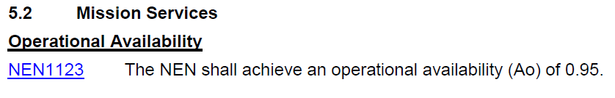
Availability Requirements
Documented availability requirements
NEN SRD has a 95% operational availability (Ao) requirement
AS2 Availability Requirements : 95% operational availability (Ao) and a 99% inherent availability (Ai)

Slide 93
Reliability, Maintainability and Availability
The measure of Reliability for AS2 shall be the Mean Time Between Failure (MTBF)
The MTBF is defined as the 20-year life cycle (200,000 hours / ~23 years) of a fully operational system divided by the predicted number of failures
Maintainability is characterized by the Mean Time to Repair (MTTR) and includes the corrective maintenance time but not logistics and administrative delays inherent to the maintenance process
Logistics delays include the time required to replace units at the failure location
Administrative delays include the time required for maintenance personnel and test equipment to arrive at the failure location
Inherent Availability (Ai) is the probability that a system or equipment, when used under stated conditions in an ideal support environment (i.e., using available tools, spares, and personnel) will operate within specifications at all times
Ai excludes preventive maintenance actions, logistics supply time, and administrative downtime and is defined as:
Ai = MTBF / (MTBF + MTTR) where MTBF = mean time between failure and MTTR = mean time to repair.
Operational Availability (Ao) is defined as:
Ao = Time Service is Available / (Time Service is Available + Time Service is Not Available)

Slide 94
RMA Analysis – Backend Electronics
MTBCF = Mean Time Between Critical Failure

Slide 95
RMA Analysis – System
MTBCF = Mean Time Between Critical Failure

Slide 96
Inherent Availability (Ai) and Operational Availability (Ao)
The calculated Backend Electronics and System availability (Ai and Ao) values exceed requirements:
NEN SRD operational availability requirement is 95%
SCNS operational availability contractual requirement for all systems is 99.0% when measured over a 6 month average, 99.1% Proficiency measured monthly
AS2 Availability Requirement : 95% operational availability (Ao) and a 99.5% inherent availability (Ai)
Backend Electronics Availability | System Availability
Ai = 99.91% | Ai = 99.66%
Ao = 99.91% | Ao = 99.66%

Slide 97
RMA Summary
SRR Entrance Criteria satisfied (E-6k)
(6k) RMA analysis verified candidate COTS hardware exceeds system availability requirements
SRR Success Criteria evidence (S-1, S-9)
(1) Results of analysis indicate the functional and performance requirements defined for the system represent achievable capabilities
(9) System requirements and available product technology support proceeding to the design phase

Slide 98
Logistics and CM Plan
Nancy Linton
1 | Introduction
2 | Project Management
3 | System Overview
4 | Operations Concept
5 | Requirements Management
6 | RTVM
7 | System Performance Analysis
8 | RMA Analysis
9 | Logistics and CM Plan
10 | Environmental, Health, and Safety
11 | Risk Management
12 | Conclusion

Slide 99
Logistics
AS2 we share spares where possible with AS1 and AS3
AS2 will have redundant hot spares for the S-band uplink and downlink RF equipment and X-Band receive RF equipment
ASF will stock high-priority spares
ASF will stock AS2 unique antenna and HPA spares
UAF/GI provides property management for all tagged and tracked property
Tracked property will be stored in access-controlled areas
ASF shares shelf spares with Wallops and they are:
RF/IF, switching, telemetry processing and fiber equipment
Wallops will provide central logistics support, including:
Spares not pre-staged to ASF
Repairs of failed equipment
Calibration of test equipment

Slide 100
Sparing Philosophy Requirements
During the procurement process the AS2 project will require vendors to provide the following information:
A breakdown of components to the Line Replaceable Unit (LRU) level
A provisional parts list with details of the original equipment manufacturer (OEM) for each line item
Reliability information for each LRU based on one of the following:
Historical information for COTS equipment or equipment of a similar design
Recommended sparing policy (unit, major assembly, LRU, piece parts) and a list of recommended spares based on AS2 availability and requirements
Identification of each part or item in equipment proposed that are obsolete or will become obsolete within 12 months or that have a limited source of supply
Recommended O&M test equipment
A list of critical spares (a critical spare represents a single point of failure of the system), non-critical spares and consumable items are required for equipment maintenance.
List of consumable items recommended to be kept in stock

Slide 101
Configuration Management (1 of 2)
NASA and SCNS coordinate with ASF to conduct developmental engineering activities for the NASA-owned assets
Deliver new equipment and upgrade packages to ASF
Deliver upgrade documentation to ASF
Provide initial training on new/upgraded systems
ASF conducts sustaining engineering activities to maintain the delivered capabilities
Performs analysis, preventative and corrective maintenance
Maintains the system documentation, including block diagrams, rack elevation drawings and wire/cable listings
Coordinates modifications with SCNS
Reports system maintenance to SCNS
Software configuration management is performed by Wallops Engineering
ASF maintains a soft copy backup of HWCNTRL configurations and vendor software
Operational configurations (HWCNTRL, PTP) are developed by Wallops and delivered to ASF

Slide 102
Configuration Management (2 of 2)
ASF Documentation Management
Hard Copies
Minimum of two copies are kept on site in the Working Library and Archive Library
Hard Copy library maintained by the Ground Station Engineer and Maintenance Technician
Soft Copies (PDF, Word, Excel etc.)
Soft copies archived on server and backed up
Ground Station Engineering and Maintenance personnel have working copies
Working copies maintained on work stations
iPads are used as a portable, second working copy
Ground Station Engineer maintains and updates soft copy archive and iPad libraries
Modifications and updates
Maintained/Added to soft copy archive
Distributed to personnel (Work stations and iPads)
Provided to WGS personnel
The University of Alaska , Fairbanks (UAF) works jointly with Wallops to manage equipment configuration and NASA property tags
UAF tracks serial numbers, equipment description, property tag number and physical location for every piece of equipment valued over $5,000

Slide 103
AS2 Requirements/Configuration Management
Configuration Management of AS2 Project requirements (Level 3) is conducted according to NASA CCB processes, including:
Generating and reviewing project requirements
Baselining project requirements in a System Requirements Document (SRD) boarded by CCB and published on the NGIN document repository
Updating the SRD via a Configuration Change Request approved by CCB
SCNS is AS9100 certified¹
¹ AS9100 is a widely adopted and standardized quality management system for the aerospace industry. It was released in October, 1999, by the Society of Automotive Engineers and the European Association of Aerospace Industries.

Slide 104
Logistics and CM Plan Summary
SRR Entrance Criteria satisfied (E-6f, E-6p)
(6f) Configuration management of the AS2 SRD by NASA CCB will be accordance with Configuration Management Procedure 450-PG-1410.2.1. Configuration management of the RTVM will be in accordance with the SCNS Near Earth Network Engineering and Configuration Management Process (SCNS-NEN-LOP-0002) and the SCNS NEN Configuration Review Board Charter (SCNS-NEN-CRB-0001)
Several database tools capture the NEN configuration
(6p) AS2 hardware and software additions to the NEN baseline do not impact SCNS staffing levels for Operations and Maintenance
SRR Success Criteria evidence (S-7, S-9)
(7) SCNS is compliant with applicable NASA and GSFC requirements, standards, processes, and procedures
(9) Program resources are sufficient to proceed to the design phase

Slide 105
Environmental Health & Safety
Chris Quinn
1 | Introduction
2 | Project Management
3 | System Overview
4 | Operations Concept
5 | Requirements Management
6 | RTVM
7 | System Performance Analysis
8 | RMA Analysis
9 | Logistics and CM Plan
10 | Environmental, Health, and Safety
11 | Risk Management
12 | Conclusion

Slide 106
Environmental Health & Safety (EHS) Purpose
The AS2 system design shall meet all applicable safety requirements of NASA Procedural Requirements (NPR) 8715.3, NASA General Safety Program Requirements
Comprehensive analysis of entire lifecycle of project ensures personnel safety and systems safety
Hazard and aspect analysis completed to comply with safety standards and ensure mission success throughout the entire lifecycle of AS2 project

Slide 107
AS2 Safety Process
Integrated approach including system/subsystem engineers and SCNS and WFF ESH Personnel
System design reviewed utilizing checklists and brainstorming to identify potential hazards
Hazard assessment will be documented on a preliminary hazard assessment/operational hazard assessment and action items will be tracked on a verification tracking log to completion
Will assess all identified hazards for risks to personnel and systems and determined the likelihood and severity based SCNS Risk Management Plan
Will select and evaluate current controls and mitigations for all identified hazards based on the hierarchy of controls
Will select controls and mitigations to reduce the risk of all hazards as low as possible
No high residual risks for hazards identified after mitigation

Slide 108
Assessment Considerations
Consider the entire lifecycle of the system in the analysis
Remember SHELL – D
Evaluate personnel safety as well as systems safety (including software safety)
Utilize lessons learned and mishap data
Incorporate personnel who have experience in these systems and their pre-existing systems – excellent resource for improvements
Software
Hardware
Environment
Liveware individuals
Liveware team
Documents

Slide 109
AS2 Actions Prior to SRR
The AS2 design team meet and completed an initial Preliminary Hazard Assessment (PHA) for the project
Initial PHA focused on safety aspects of the design of the AS2 and the impact of the design on operations to identify key safety requirements
Team conducted PHA was a cross functional team that included project managers, engineers, UAF Risk Manager, UAF NEN Station personnel, SCNS Safety and Mission Assurance (SMA) and NASA SMA personnel
There were 46 total environmental and safety considerations identified during the initial PHA which are being actively managed by the design team to ensure adequate and effective control
Items identified in the PHA will be tracked through the project life cycle and progress towards their evaluation and control presented at future design gates
The AS2 team also developed questions and met with personnel from the UAF to identify UAF specific requirements

Slide 110
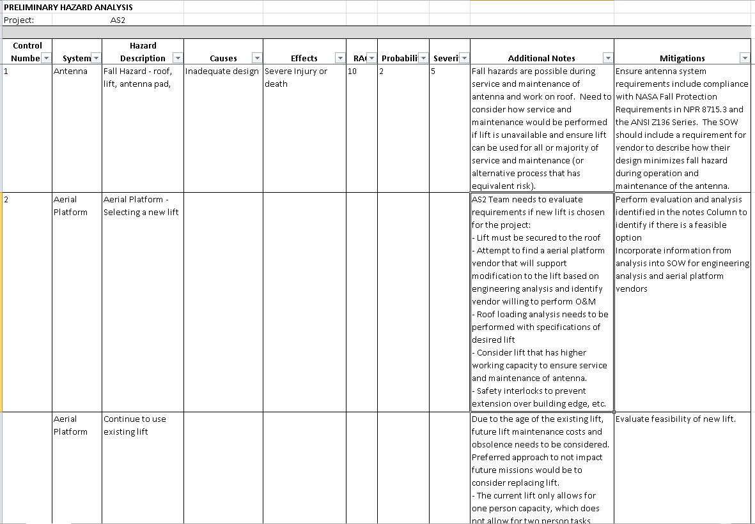
Preliminary Hazard Assessment (Sample*)
* Full Preliminary Hazard Assessment available up on request.

Slide 111

ESH Involvement AS2 Project Lifecycle
Support requirement building and SOW development
Integrated team to participate in preliminary hazard assessment of the design
Continue to support project in evaluation of vendor plans and designs to evaluate controls for identified hazards and assess for any new hazards
Provide safety support during installation of system including communication and oversight of contractors
Coordinate with Managers and Training coordinators to deliver required ESH training for operation, maintenance, and service of the system
SAFETY BEGINS WITH
Teamwork

Slide 112
Environmental Health & Safety Summary
SRR Entrance Criteria satisfied (E-6i, E-6s)
(6i) SCNS safety policy complies with NPR 8715.3 and the NEN CRB evaluates changes to the baseline to ensure we have made adequate risk informed decisions so that these changes do not impact the safety or reliability of the mission
(6s) SCNS and Code 300 share SMA responsibilities for the NEN
SRR Success Criteria evidence ( S-9)
(7) SCNS is compliant with applicable NASA and GSFC requirements, standards, processes, and procedures
(9) The AS2 replacement project will collaborate with NASA GSFC Code 300 to ensure compliance with policies, processes, requirements, and standards levied by the agency, GSFC, and the NEN project

Slide 113
Risk Management
Brenda Knudtson
1 | Introduction
2 | Project Management
3 | System Overview
4 | Operations Concept
5 | Requirements Management
6 | RTVM
7 | System Performance Analysis
8 | RMA Analsysis
9 | Logistics and CM Plan
10 | Environmental, Health, and Safety
11 | Risk Management
12 | Conclusion

Slide 114
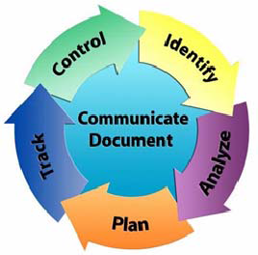
Risk Management Process
The AS2 project has identified preliminary risk sources that will be reassessed periodically to determine if any risks should be identified. Any risks identified will be reported to the NEN Project on a monthly basis
As a project under the NEN, the AS2 project will adhere to the NEN Risk Management Plan, 453-PLAN-0003
The following bullets outline the proposed AS2 risk process, which is in compliance with the NEN Risk Management Plan
Any members of the project can act as a risk identifier
As the project develops, potential risk sources will be monitored to see if any risks are identified
Any identified preliminary risks will be provided to the NEN Risk Management Board and evaluated at the NEN Project Monthly Status Review (MSR)
Any assigned risk owners will be ultimately responsible for executing their risk handling plans, providing tracking status, and communication of all tasks in the plan

Slide 115
AS2 Risk Sources
Held risk identification brainstorming exercise on March 2, 2015
Used Risk Breakdown Structure
The team met 11/13/15 to status “Areas to be Assessed for Risks”
Following potential risk sources are being watched to determine if risks should be written:
Risk Source | Areas to be Assessed for Risks | Status
Quality | Reliability Maintainability & Availability Results | Preliminary assessment was completed (results are included in the SRR) and will be updated whenever equipment is identified and procured. No risks identified currently.
Specs/Regs/ Standards | Radio Frequency Emissions | Analysis completed. No risks were identified as a result from the analysis. The safety assessment to be performed after the antenna SAT.
Facilities | Building Structural Analysis | Currently underway and scheduled to be finalized in 3 weeks.
Environment | Weather is currently not a risk yet. Schedule slips into colder weather could affect the following: Road restrictions or lifts -> could result in 2 to 8 week impact on schedule Additional heat and lighting supplied -> could impact cost Concrete pour -> could impact cost | Currently no schedule slips.
Facilities | Site assessment including antenna pad, power (including grounding), cooling, other facilities requirements | Design Alaska is currently performing and assessment on the pad. Antenna vendor will also perform an assessment on the pad. Site survey will assess facility requirements.
Unit changes | Any components with significant changes such as Cortex Receiver (changes every 2-3 years) | As design progresses, the configuration changes of the individual units will be managed. The team will evaluate any differences from the legacy design.

Slide 116
AS2 Risk Process Summary
Active RM process follows CRM from project inception to closure
All risks are reviewed quarterly at a minimum
Executive control through monthly RMB
AS2 risk identification exercise has been completed
Any resulting risks will be analyzed and handling plans developed
Risk status will be actively tracked, controlled, and communicated
No risks are currently identified for the AS2 Project
Brenda Knudtson, Risk Manager: 301.823.2589
Any team member may identify risks

Slide 117
Risk Management Summary
SRR Entrance Criteria satisfied (E-6d, E-6e)
(6d) The AS2 replacement project will adhere to the NEN Risk Management Plan: 453-PLAN-0003
(6e) To date no risks have been identified
SRR Success Criteria evidence (S-6, S-9)
(6) To date no risks have been identified
(9) To date no risks have been identified

Slide 118
Conclusion
Ryan Turner
1 | Introduction
2 | Project Management
3 | System Overview
4 | Operations Concept
5 | Requirements Management
6 | RTVM
7 | System Performance Analysis
8 | RMA Analysis
9 | Logistics and CM Plan
10 | Environmental, Health, and Safety
11 | Risk Management
12 | Conclusion

Slide 119
AS2 Replacement SRR Criteria Satisfied by Each Section
The AS2 Replacement Project thanks the board for their participation in the SRR
Review material presented and accompanying documentation demonstrates that the project has satisfied review criteria
Section # | Title | Description | Criteria Met
 |  |  | Entrance | Success
1 | Introduction | Present Board Members, purpose and scope, success criteria, project background and assumptions
2 | Project Management | Present project team, technology readiness assessment, document tree, project management process, facilities, schedule and WBS | 4, 5b, 6g, 6l, 6m, 6u | 9
3 | System Overview | Provide, high level block diagram, notional architecture, and software development approach | 6b, 6t, 6v | 4, 9
4 | Operations Concept | Describe AS2 operations concept | 6b, 6t, 6v | 9
5 | Requirements Management | Present requirements management process and summary of requirements contained in the AS2 SRD | 5a, 6c, 6j | 1, 2, 3, 4, 8, 9
6 | RTVM | Describe verification and validation methods and present a sample of the RTVM | 6c, 6h | 5, 9
7 | System Performance Analysis | Describe anticipated performance based on initial analyses, e.g., RF performance, RF compatibility, structural variability | 6k | 1, 9
8 | RMA Analysis | Describe results of initial RMA analysis | 6k | 1, 9
9 | Logistics and CM Plan | Describe logistics, sparing and CM plans | 6f, 6p | 7, 9
10 | Environmental, Health, and Safety | Describe results of initial hazard analysis and EHS management plan | 6i, 6s | 7, 9
11 | Risk Management | Present risk management plan and status of risks identified | 6d, 6e | 6, 9
12 | Conclusion
Notes:
Entrance Criteria 6v and exit criteria 9 both refer to the entrance/exit criteria in NASA-HDBK-2203. According to Matt, the criteria is as follows:
Process for allocation and control of requirements throughout all levels is deemed sound; plan is defined to complete the definition activity within schedule constraints.
Requirements definition is complete with respect to top-level mission and science requirements; interfaces with external entities and between major internal elements are defined.
Preliminary allocation of system requirements to hardware, human, and software subsystems is defined.
Requirements allocation and flow down of key driving requirements are defined down to subsystems.
Preliminary approaches have been determined for how requirements will be verified and validated down to the subsystem level.
Major risks have been identified and technically assessed, and viable mitigation strategies defined.
Requirements and selected concept of operations will satisfy the mission.
System requirements, approved material solution, available product/process technology, and program resources are sufficient to proceed to the next life cycle phase.

Slide 120
SRR Success Criteria
The Review Chair agreed that the Entrance Criteria defined in NPR 7123.1B was met going into the SRR. As demonstrated today, we believe the AS2 Replacement Project has met the success criteria defined in NPR 7123.1B:
# | Success Criteria | Evidence
1 | The functional and performance requirements defined for the system are responsive to the parent requirements and represent achievable capabilities. | ✓
2 | The maturity of the requirements definition and associated plans is sufficient to begin Phase B | ✓
3 | The project utilizes a sound process for the allocation and control of requirements throughout all levels, and a plan has been defined to complete the requirements definition at lower levels within schedule constraints. | ✓
4 | Interfaces with external entities and between major internal elements have been identified. | ✓
5 | Preliminary approaches have been determined for how requirements will be verified and validated. | ✓
6 | Major risks have been identified and technically assessed, and viable mitigation strategies have been defined. | ✓
7 | The program/project has demonstrated compliance with applicable NASA and implementing Center requirements, standards, processes, and procedures. | ✓
8 | TBD and TBR items are clearly identified with acceptable plans and schedule for their disposition. | ✓
9 | Software components meet the exit criteria defined in NASA-HDBK-2203, NASA Software Engineering Handbook. | ✓
Do the SRR board members grant us authorization to proceed past SRR?

Slide 121
Board Discussion

Slide 122
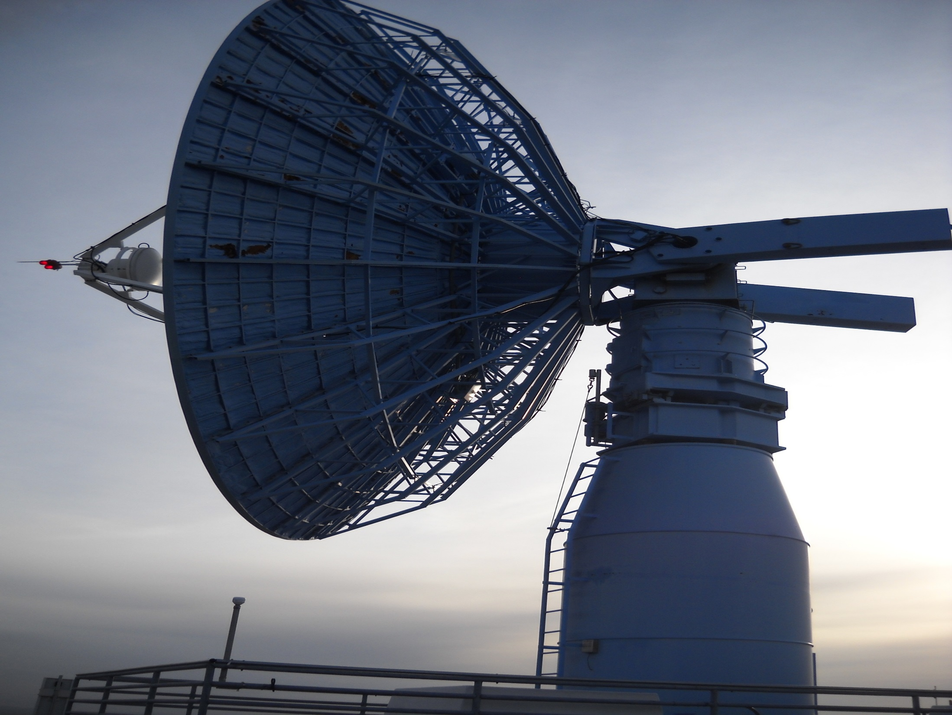
RFA Review

Slide 123
BACKUP

Slide 124
Backup: Applicable NEE SRD Requirements Figures and Tables
Not applicable

Slide 125
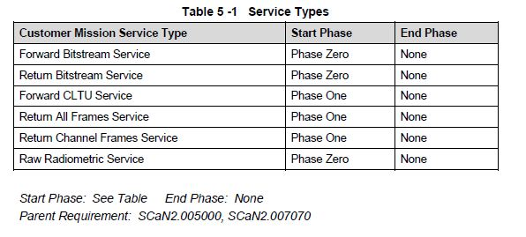
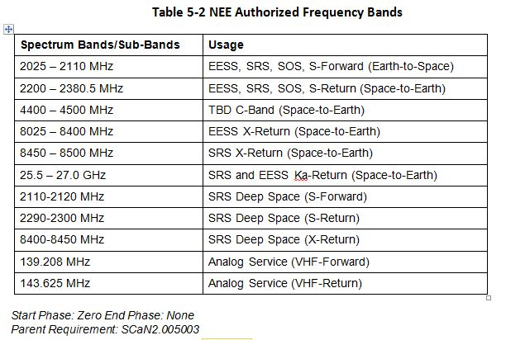
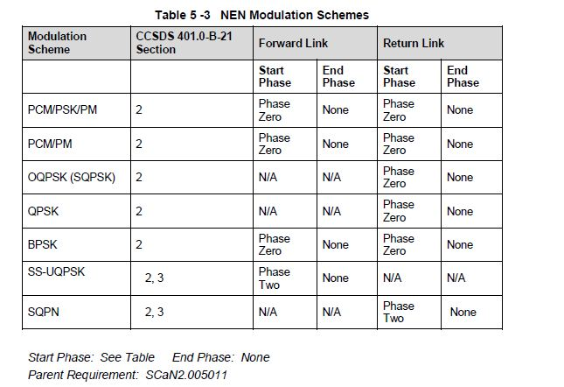
NEE SRD Tables and Figures (1 of 4)

Slide 126
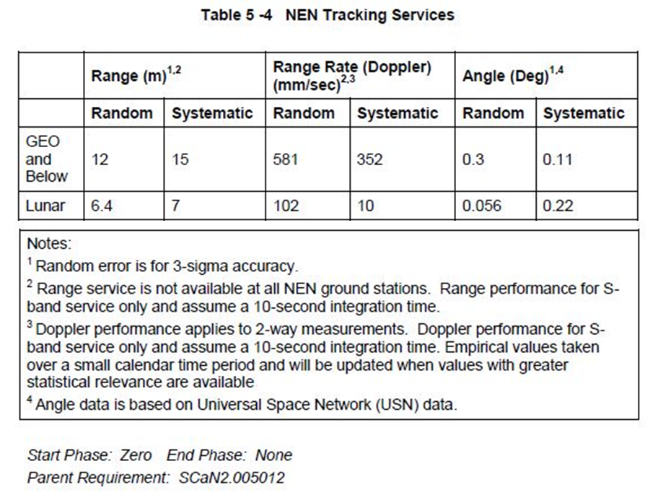
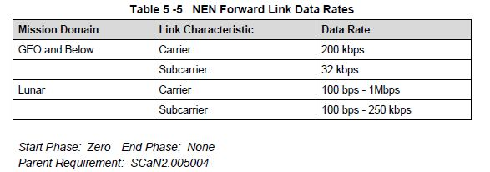
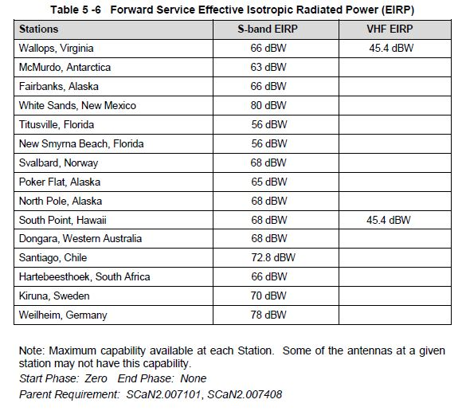
NEE SRD Tables and Figures (2 of 4)

Slide 127
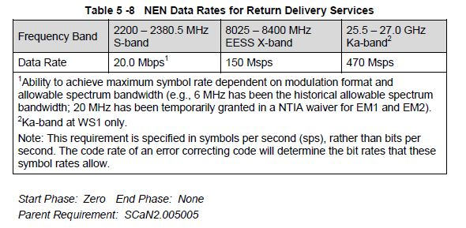
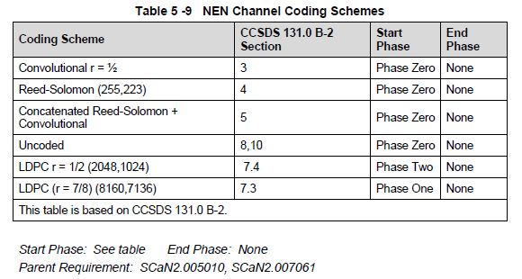
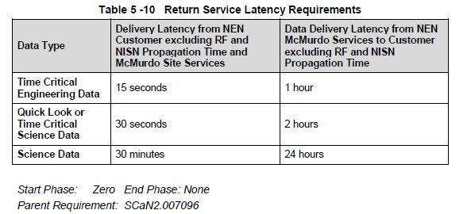
NEE SRD Tables and Figures (3 of 4)

Slide 128
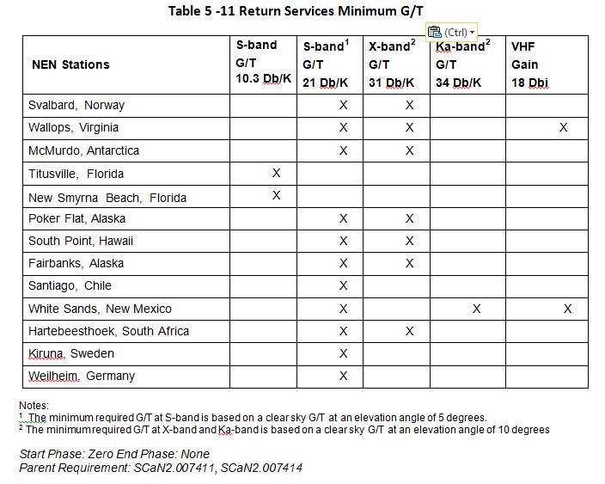
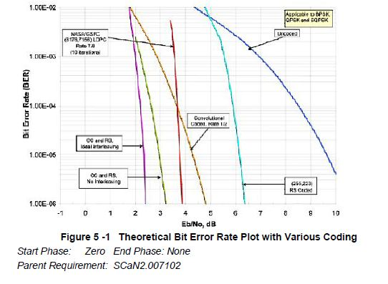
NEE SRD Tables and Figures (4 of 4)

Slide 129
Backup: AS2 Network
Not applicable

Slide 130
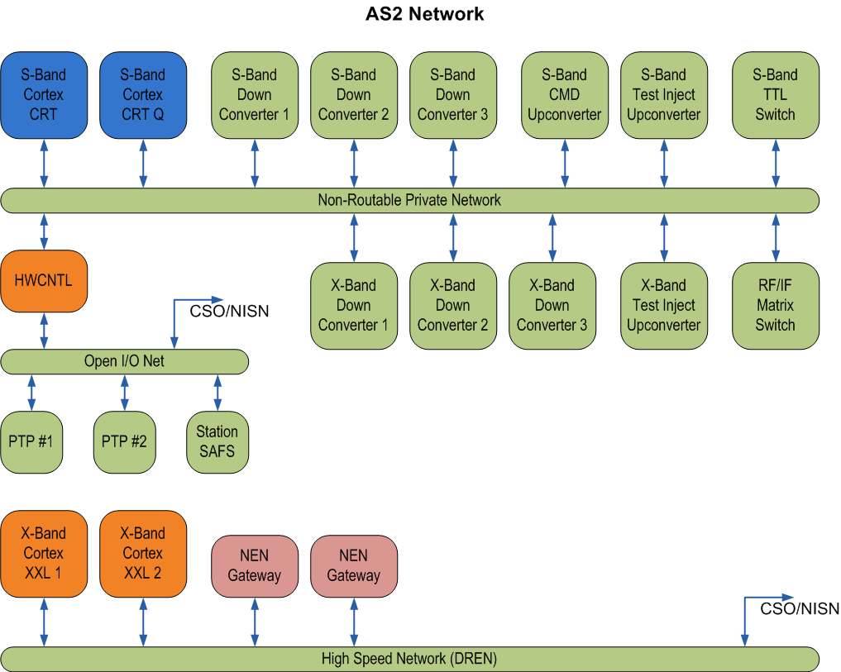
AS2 Network

Slide 131
Backup: RMA Analysis
Not applicable

Slide 132
Reliability
The measure of Reliability for AS2 shall be the Mean Time Between Failure (MTBF)
The MTBF is defined as the 20-year life cycle (200,000 hours / ~23 years) of a fully operational system divided by the predicted number of failures
Acceptable MTBF for AS is not specifically identified; however, MTBF contributes to the required inherent availability for the system
The MTBF for any identified equipment group is defined as the life cycle period of the equipment divided by the predicted number of failures
The MTBF is determined in accordance with MIL-HDBK-217, Reliability Prediction of Electronic Equipment.
AS2 support function service elements shall be designed to be sufficiently robust to reliably provide the service during the operational period (200,000 hours / ~23 years)
AS2 will incorporate sufficient hot redundancy and cold shelf spares to meet the service wide availability and maximum downtime requirements

Slide 133
Maintainability
Maintainability is characterized by the Mean Time to Repair (MTTR) and includes the corrective maintenance time but not logistics and administrative delays inherent to the maintenance process
Logistics delays include the time required to replace units at the failure location
Administrative delays include the time required for maintenance personnel and test equipment to arrive at the failure location
MTTR, as the measure of maintainability is defined as the sum of corrective maintenance times at any specific level of repair divided by the total number of failures within an item repaired at that level during a particular interval under stated conditions
The MTTR includes the maintenance times for the first level maintenance; time that is required for second level maintenance is not a part of MTTR
The MTTR shall be less than 8 hours in the event the service function has already lost its active redundancy and spare equipment needs to be installed
A system and process of Fault Isolation shall be provided to facilitate the isolation of failures
Failures shall be isolated to one chassis or Line Replaceable Unit (LRU), whichever is smaller
Manual intervention can be used to isolate failures to below the chassis or LRU level

Slide 134
Availability
Inherent Availability (Ai) is the probability that a system or equipment, when used under stated conditions in an ideal support environment (i.e., using available tools, spares, and personnel) will operate within specifications at all times
Ai excludes preventive maintenance actions, logistics supply time, and administrative downtime and is defined as:
Ai = MTBF / (MTBF + MTTR) where MTBF = mean time between failure =MTBF(20000 hours)/Failure rate
and MTTR = mean time to repair
With the exception of absolute station priorities, maintenance and safety requirements, AS2 shall be operate 24hrs/day, 7days/week, 52 weeks/year
Operational Availability (Ao) is defined as:
Ao = Time Service is Available / (Time Service is Available + Time Service is Not Available)
Available service time should be measured over a contiguous 20 years (200,000 hours / ~23 years) interval except that any loss of availability due to loss of facility services such as power or air conditioning, or loss of system capability resulting from unusual weather conditions, such as icing or severe rain storms, is not counted
The time service is not available includes all times service is not available due to corrective maintenance downtime, administrative downtime, logistics supply downtime, and preventive maintenance downtime

Slide 135
RMA Calculation Assumptions
MTBF for any identified equipment group is defined as the life cycle period of the equipment divided by the predicted number of failures
Most COTS vendors cannot provide MTBF estimates therefore when measured data or computed estimates are not available, we assumed:
24,000 hours for computer-based equipment (PCs, servers containing disk drives)
80,000 hours for fixed location, solid-state, low-power devices
Simplifying assumptions
Wires and connectors in this fixed application have infinite MTBF (not true, but reliability is generally high enough that these items will not affect the outcome)
Services external to AS2 (e.g., Power, Communication, etc.) have an availability value of 1

Slide 136
Backup: Acronym and Abbreviation List
Not applicable

Slide 137
Acronym and Abbreviation List (1/3)
1PPS | One Pulse Per Second
AI | Action Item
ACRIMSAT | Active Cavity Radiometer Irradiance Monitor Satellite
ACU | Antenna Control Unit
ADEOS | Advanced Earth Observing Satellite
AIM | Aeronomy of Ice in the Mesosphere
AOS | acquisition of signal
AS | Antenna Aub-system
ASF | Alaska Satellite Facility
AS1 | ViaSat 11-m antenna at ASF
AS2 | 10-m antenna at ASF
AS3 | Datron 11-m antenna at ASF
ASM | Attached Sync Marker
BER | Bit Error Rate
BERT | Bit Error Rate Test
BPSK | Binary-phase Shift Key
CCSDS | Consultative Committee for Space Data Systems
CDR | Critical Design Review
CDS | Comprehensive Discrepancy System
Ch | Channel
CI | Configuration Item
CM | Configuration Management
CMD | Command
COMPAT | Compatibility
COTS | Commercial Off-The-Shelf
CRT | Command Range Telemetry
CRT-Q | Command Range Telemetry - Quantum
CSO | Communications Services Organization
CTL | Control
CTA | Compatibility Test Area
D/C | Down-converter
Db | decibel
dBc | ratio in decibels (dB) relative to the Carrier
dBi | decibels (dB) Isotropic
dBm | power ratio in decibels (dB) of the measured power
dBW | decibel watts
dBWi | decibel watts isotropic
Dll | Dynamic-Link Library
DM | Data Management
DR | discrepancy report
Eb/No | Energy per bit (Eb) to Spectral Noise Density (No)
EBnet | Earth Observing System Backbone network
EBOX | EDOS box
EC | Engineering Change
ECAS | Engineering Change Automation System
ECL | Emitter Coupled Logic
EDOS | Earth Observation System (EOS) Data Operations System
EHS | Environmental Health & Safety
EIRP | Effective Isotropic Radiated Power
El | Elevation
EO-1 | Earth Orbiter 1
EOL | End Of Life
EOS | Earth Observing System
EPR | Engineering Peer Review
FASTSAT | Fast, Affordable, Science and Technology Satellite
FAT | Factory Acceptance Test
FDF | Flight Dynamics Facility
FEP | Front End Processor
FIPS | Federal Information Processing Standards
FO | Fiber Optic
FOP | File Output Processor
FY | Fiscal Year
G/T | Gain to System Noise Temperature
Gbyte | Gigabyte

Slide 138
Acronym and Abbreviation List (2/3)
GFE | Government Furnished Equipment
GI | Geophysical Institute
GOES 12-15 | Geostationary Operational Environmental Satellite
GPM | Global Precipitation Measurement
GPS | Global Positioning System
GRACE 1 | Gravity Recovery and Climate Experiment 1
GRACE FO | Gravity Recovery and Climate Experiment Follow On
HESSI | High Energy Solar Spectroscopic Imager
HK | Housekeeping
HPA | High Power Amplifier
HWCNTRL | Hardware Control
Hz | Hertz
I&T | Integration and Test
ICD | Interface Control Document
ICESat-2 | Ice, Cloud, and land Elevation Satellite-2
Inj. | Injection
IONet | Internet Protocol Operational Network
IF | intermediate frequency
IRIG | Inter-Range Instrumentation Group
IRIS | Interface Region Imaging Spectrograph
IT | Information Techonlogy
kbps | Kilobits Per Second
ksps | Kilosymbols Per Second
LADEE | Lunar Atmosphere and Dust Environment Explorer
LANDSAT 5 | Land Remote Sensing Satellite
LDPC | Low Density Parity Check
LHCP | Left Hand Circular Polar
LNA | Low Noise Amplifier
LRU | line replaceable unit
M&C | Monitor and Control
Mbyte | Megabyte
MCE | Mission Commitment Engineer
MCS | Monitor & Control Sub-system
MetOp | Meteorological Operational
MG1 | 10-m antenna at MGS
MGS | McMurdo Ground Station
MHz | Mega Hertz
MMS | Magnetospheric Multi-Scale Mission
MOC | Mission Operations Center
Msps | Mega-symbols per second
MTRS-U | McMurdo TDRS Relay Station Upgrade
MUE | mission unique equipment
NEE | Near Earth Element
NEN | Near Earth Network
NEN UG | Near Earth Network Users Guide
NENG | Near Earth Network Gateway
NENPAO | Near Earth Network Performance Analyst Office
NENSO | Near Earth Network Scheduling Office
NENSS | Near Earth Network Scheduling System
NIM | Network Integration Manager
NIMO | Network Integration Management Office
NISN | NASA Integrated Services Network
NIST | National Institute of Standards and Technology
NOSP | Network Operations Support Plan
NRD | Network Requirements Document
NRZ-L | Nonreturn-to-zero – Level
NRZ-M | Nonreturn-to-zero - Mark
NRZ-S | Nonreturn-to-zero - Space
NTP | Network Timing Protocol
O&M | Operations and Maintenance
OCO2 | Orbiting Carbon Observatory 2
ODR | Operational Discrepancy Report
OQPSK | Offset Quadrature Phase Shift Key
ORR | Operational Readiness Review

Slide 139
Acronym and Abbreviation List (3/3)
PDR | Preliminary Design Review
PTP | Programmable Telemetry Processor
QAC | Quality and Accounting
QUIKSCAT | Quick Scatterometer
RAID | Redundant Array of Inexpensive Disks
RBSP | Radiation Belt Storm Probe
RCVR | Receiver
RF | Radio Frequency
RFA | request for action
RFICD | Radio Frequency Interface Control Document…
RHCP | Right Hand Circular Polar
RMA | Reliability, Maintainability, and Availability
RTVM | Requirements Traceability Verification Matrix
Rx | Receive
SMA | Safety & Mission Assurance
SAC-(C, D) | Satellite de Aplicaciones Cientificas
SAMPEX | Solar Anomalous and Magnetospheric Particle Explorer
SAR | synthetic aperture radar
SAT | Site Acceptance Test
SCaN | Space Communications and Navigation
SCC | Station Control Computer
SCISAT | Scientific Satellite
SCNS | Space Communications Network Services
SCP | Secure Communications Protocol
SDR | System Design Review
SE | Systems Engineering
sftp | Secure File Transfer Protocol
SLA | Service Level Agreement
SLE | Space Link Extension
SMAP | Soil Moisture Active Passive
SORCE | Solar Radiation and Climate Experiment
SOW | Statement of Work
SRD | System Requirements Document
SRMB | SCNS Risk Management Board
SRR | Systems Requirements Review
SSPA | Solid State Power Amplifier
TBD | to be determined
TBR | to be resolved
TByte | Terabyte
TDR | Test Discrepancy Report
TDRS | Telemetry Data Relay Satellite
THEMIS | Time History of Events & Macroscale Interactions during Substorms
TLM | Telemetry
Tp | Test Point
TR | Transmit Receive
TRK | Tracking
TRR | Test Readiness Review
TTL | Transistor Logic
TURRIT | Tracking, UTDF and Ranging Real-Time Integration and Transmission
Tx | Transmit
UAF | University of Alaska, Fairbanks
U/C | Up-converter
UTDF | Universal Traffic Data Format
WBS | work break-down structure
WF1 | Wallops 11m antenna
WF2 | Wallops 5m antenna
WGS | Wallops Ground Station
WS1 | White Sands One
 | Other Past Missions
CHAMP | Comet Halley Active Monitoring Program
ERS-1 | Earth Remote-sensing Satellite-1
FAST | Fast Auroral Snapshot Explorer
JERS-1 | Japanese Earth Research Satellite-1
RADARSAT | RADAR Satellite

